Slide 1
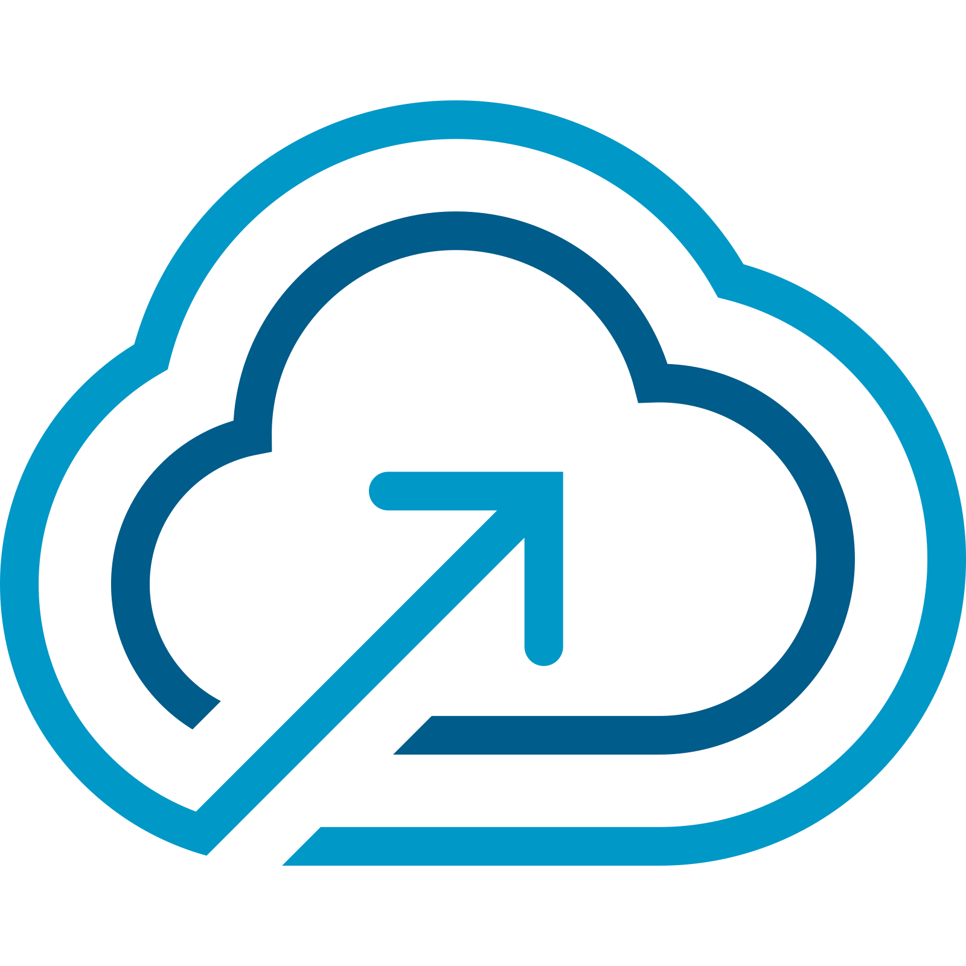
VMware Cloud Foundation 9.0
What’s New Technical – Part 2
Presenter:
June, 2024
Notes:
Key Message:
Opening slide
Talk Track:
Welcome! My name is <name> and I work in the <name or organization> at Broadcom. Today, I want to talk to you about the new features and functionality that have been added into VMware Cloud Foundation 9.
Notes:
Resources:
To gain a greater understanding of VCF features, key concepts and how they are used please refer to the VCF Technical Overview presentation.
VMware Cloud Foundation 9.0 Release Notes:
https://docs.vmware.com/en/VMware-Cloud-Foundation/index.html

Slide 2
Deliver Self-service IaaS
VCF AUTOMATION
What’s New with VCF Automation
Supervisor Services
Tenant Management
Resource Management
Organizational Management

Slide 3
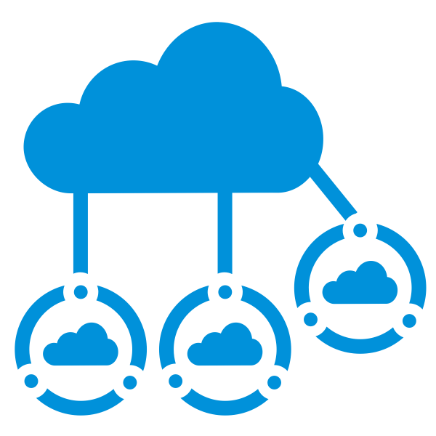


VCF Automation – Consume the Cloud
Tenant Management
Cloud Governance
End User Experience
Organize & Allocate Tenant Resources
(Tenant Management capabilities)
Tenant/LOB Admin Identity Management.
(Federated identity, groups, roles config)
Tenant Operations
(OOTB Ops, Capacity and Cost, Chargeback)
Governance Policies
(Quotas, leases, naming, showback)
Application Blueprints
(Traditional apps, Modern Apps and AI ML Apps)
Workflow Orchestration
(Event-based extensibility and workflow orchestration for IT/Business processes)
IaaS Surface for VCF
(OOTB Supervisor services - VM, K8s, Network, Storage, etc)
Application Catalog
(OOTB catalogs curating content from vCs, application catalogs, etc)
Extensible Services Ecosystem
(Object Storage, Data services, Backup, etc)
Notes:
Key Message:
VCF Automation empowers you to consume the cloud by offering an integrated experience
Talk Track:
If we want to talk about what’s NEW in VCF Automation in one snapshot slide, this is it. Three key strategic pillars comprise VCF Automation.
One is Tenant Management, which helps the IT Admins and the Service Providers take their VCF Infrastructure and allocate pieces of the infrastructure to tenants. These tenants could be either end customers in the case of a Service Provider or just internal lines of businesses in the case of Enterprise IT.
A good example would be Rackspace, a Service Provider with Coke and Pepsi as tenants.
The Service Provider can use the Tenant Management functionality to carve out the VCF infrastructure among one or many tenants.
Another example in the enterprise use case is Broadcom IT. They are using this capability for their 26 divisions to share one extensive VCF infrastructure, and they are using Tenant Management to allocate infrastructure to each division, like the VCF division, Tanzu division, ANS division, etc.
Beyond organizing and allocating resources in Tenant Management, we also consider tenant identity providers. Each tenant may have their own identity providers.
Last but not least, once the provider allocates these tenants, they want to be able to manage how the tenants are utilizing the environment, so they can perform chargeback functions.
The middle pillar is Cloud Governance.
Cloud Governance is all about the tenants or the lines of business admins. Once they receive the allocated infrastructure, they can apply governance policies for their different application teams.
This could be quotas, leases, naming, and even resource level policies. Another part of governance among application team admins would be enforcing only specific configuration workloads being provisioned by their end users. They don’t want their end user to be provisioning anything they want.
The application team admins may wish to create a blueprint that mandates you must have these kinds of VMs configured in a specific manner, with a particular load balancer connected to it, and the software to install.
So, you can define a blueprint and then publish it as a catalog item for self-service consumption, which is a form of governance that our customers love today.
The third piece of governance is around workflow orchestration. If you think about any kind of provisioning VMs or Kubernetes clusters or anything in the cloud, it’s not a standalone thing. Every VM that is provisioned inevitably requires you to orchestrate many workflows. It could be registering the VM in a CMDB and integrating it with other software. We see this as a norm in every company where they have some workflow orchestration that is required as part of their provisioning process.
The last pillar, the most important from my perspective, is the End User Experience.
The End User we mentioned before gets a self-service catalog-based experience of curated blueprint content from the providers, the line of business admins, or the application team admins. In addition, these end users, for the first time, also get a public cloud-like IaaS surface for VCF. When they enter the VCF private cloud organization portal, they automatically start seeing IaaS services like virtual machine provisioning, Kubernetes provisioning, network, etc.
With this End User Experience, we offer a wide range of extensible services like object storage, data services, and backup, with the vSphere supervisor providing this capability. We take the power of the supervisor-based services and expose them to the end users through VCF Automation.
So, looking at these three pillars, you will know that it’s not just an incremental upgrade. This brings together the tenant management, governance, projects, and blueprint capabilities, along with the new supervisor-based capabilities in vSphere for the end users. All of this put together is the new VCF Automation.
Notes:
Tenant Management
Organizing and Allocating Tenant Resources
VMware Cloud Director provides embedded tenant management capabilities, enabling seamless resource allocation for tenants across your cloud environment.
Tenant / Line of Business Admin Identity Management
Ensure secure and flexible user management with:
Federated Identity: Single sign-on capabilities across the VCF components.
Groups: Simplified management of user groups for policy enforcement.
Custom Roles: Tailor access control to meet specific tenant or business requirements.
Tenant Operations
Streamline operational management through:
Out of the Box Operations: Access predefined operational workflows for smooth and quick consumption.
Capacity and Cost Management: Monitor and optimize cloud resource usage, ensuring efficient utilization and cost savings.
Chargeback: Implement chargeback mechanisms to accurately allocate costs back to business units or tenants.
Governance and Policies
Governance Policies
Enforce critical policies for:
Quotas, Leases, Naming, and Showback: Manage resource consumption, naming conventions, and visibility into usage for accountability.
Application Blueprints
Simplify application deployment and management with pre-defined templates for:
Traditional Apps, Modern Apps, and AI/ML Applications: Support for both legacy applications and modern, dynamic workloads.
Workflow Orchestration
Automate business and IT processes through:
Event-based Extensibility: Trigger workflows based on specific events, ensuring timely and responsive automation.
Workflow Orchestration for IT/Business Processes: Align IT processes with business needs, driving efficiency and flexibility.
Modern Cloud Interface
IaaS Surface for VCF
Access out-of-the-box IaaS services, which include:
VM, Kubernetes, Network, and Storage: Provide a full spectrum of cloud services to your tenants with a flexible, scalable infrastructure.
Application Catalog
Access a rich catalog of services with:
Pre-curated content from vCenters and application catalogs: Simplify the deployment and management of applications with ready-to-use templates and resources.
Extensible Services Ecosystem
Manage extensible services through a centralized interface:
Object Storage, Data Services, Backup, DR, etc.: Integrate and manage services like object storage, disaster recovery, and backup seamlessly within the cloud environment.
Resources:

Slide 4


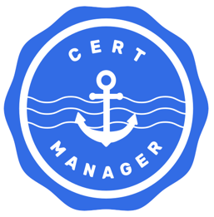
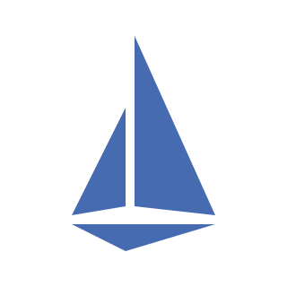
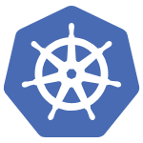
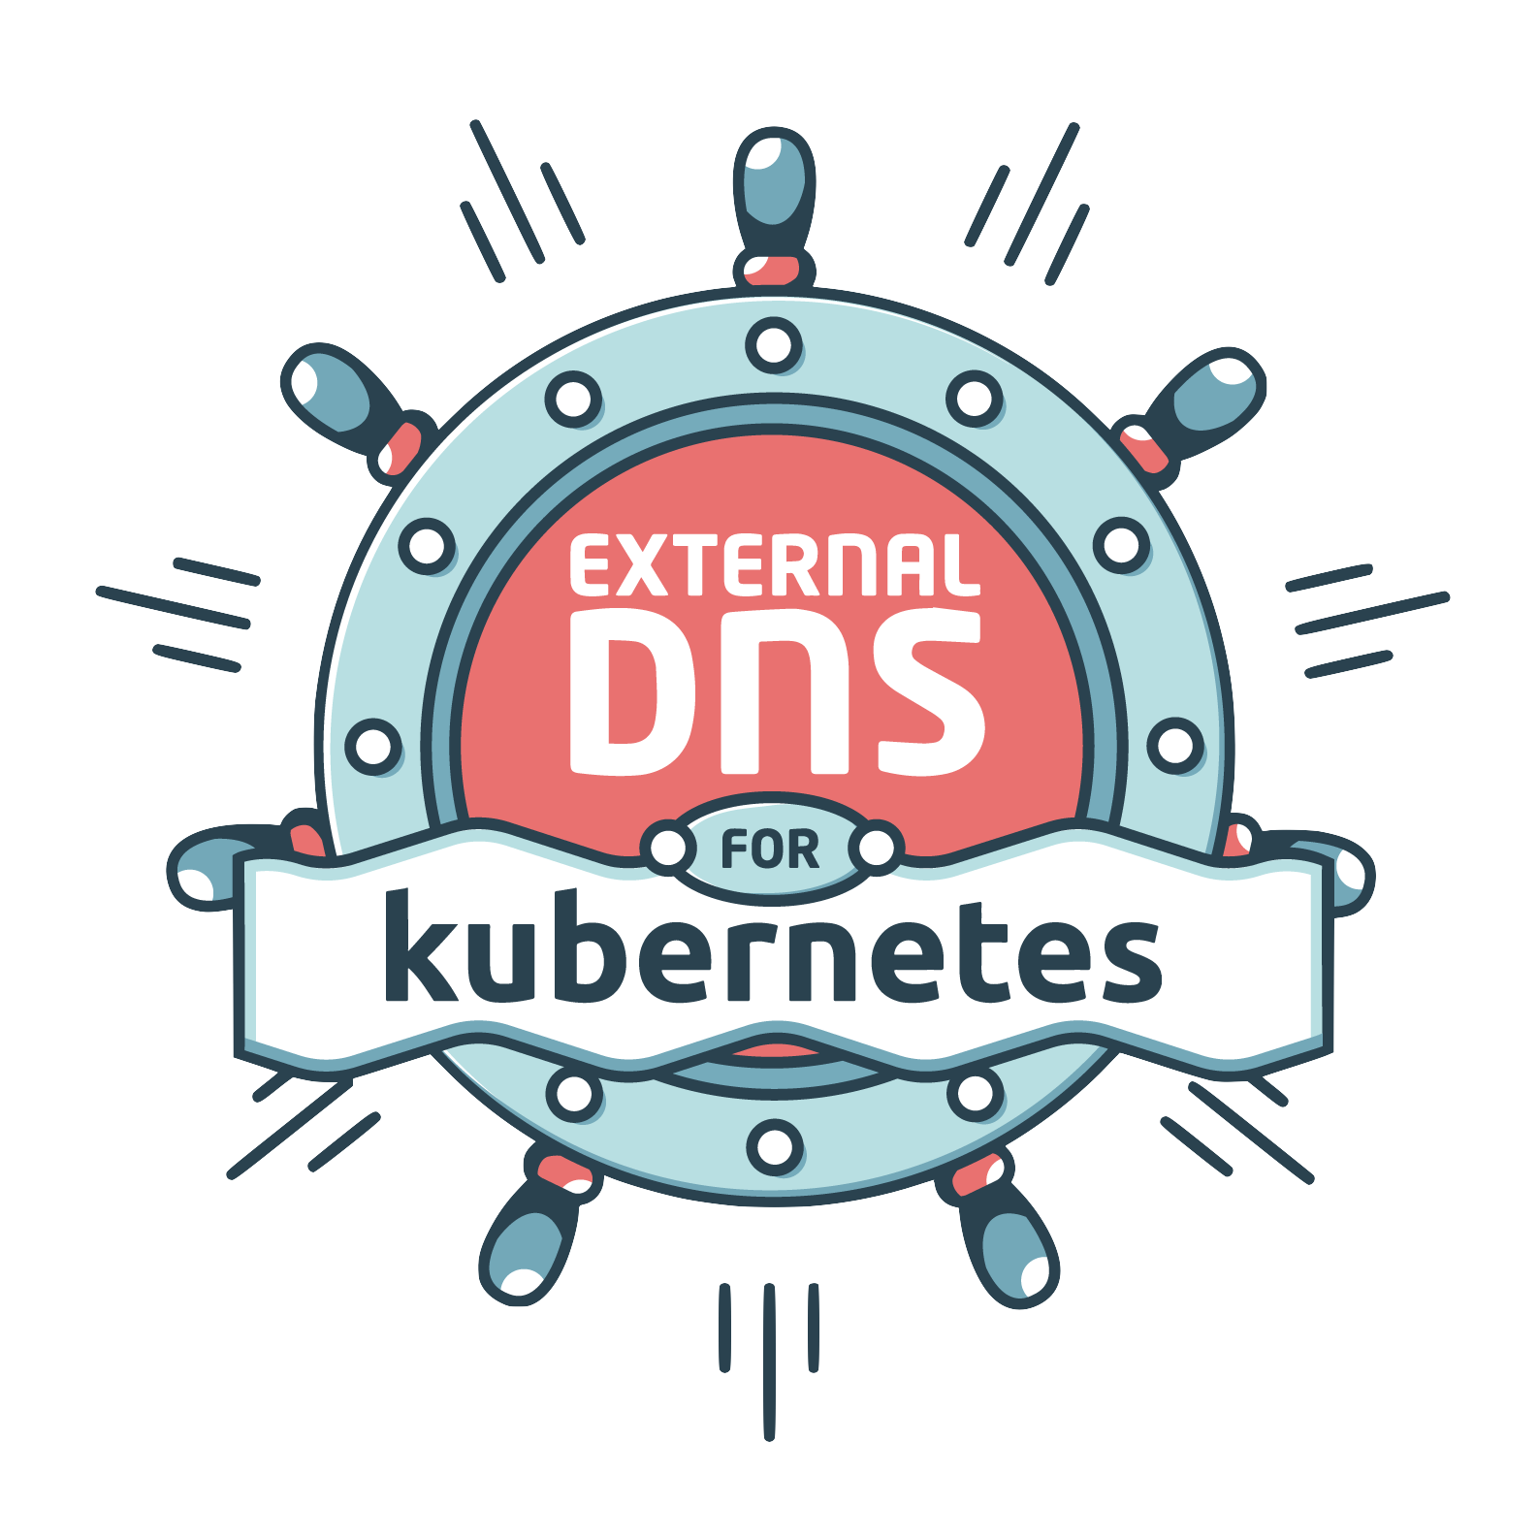

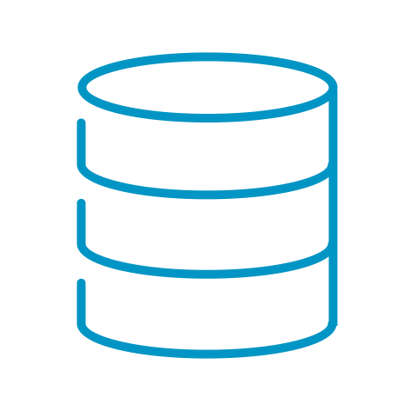

Supervisor Services
Deliver public cloud-like IaaS services in a private cloud, straight out-of-the-box. Expand with extensible services, increasing developer satisfaction.
VMware Cloud Foundation
Applications / Workloads
AI
K8s
VM
Supervisor Services
Core Services
Extensible Services
VM Service
vSphere Kubernetes Service (VKS)
VM Image
Image Registry
K8s Ingress Controller
Certificate Management
Service Mesh
New!
VM
Network Service
Volume Service
Velero
Backup Service
External DNS
DSM Consumption Operator
Secret Store
…
vSphere Supervisor
COMPUTE
STORAGE
NETWORKING
Note: Availability of certain features differ between Org for VM Apps and Org for All Apps experience
Notes:
Key Message:
In VCF 9.x, Supervisor Services are exposed across your environments and users have a choice to consume these services via UI, CLI, or Kubernetes-native APIs, they’ve got multiple ways to access and consume services — just like they would in a public cloud. Each service is namespace-scoped, meaning they operate within defined resource boundaries. The model provides a self-service experience, and dev teams can move fast as they can consume infrastructure without complexity and ticket wait times.
Talk Track:
In VCF 9.x, Supervisor Services are exposed across your environments, and users have a choice to consume these services via UI, CLI, or Kubernetes-native APIs; they’ve got multiple ways to access and consume services, just like they would in a public cloud. Each service is namespace-scoped, meaning it operates within defined resource boundaries. The model provides a self-service experience; dev teams can move fast as they can consume infrastructure without complexity and wait times for tickets.
Notes:
Let’s walk through some of the key Core services available out of the box:
VM Service - lets users declaratively define and deploy virtual machines using the VM Operator. The VM Service defines VM specs like CPU, memory, networks, power state, etc. The end user can also configure additional settings like Persistent Volume Claims, Load Balancers, Cloud-Init Scripts. This provides a comprehensive way to deploy a modern app onto a VM.
K8s Service - allows you to spin up Kubernetes clusters on demand. The vSphere Kubernetes Service can be used to deploy Kubernetes clusters quickly and easily, without the overhead of managing complex infrastructure manually. This service handles resource allocation, scalability, fault isolation, certificate management, and much more. One advantage to using this service is that you can deploy multiple versions of Kubernetes, making it perfect for testing new features or ensuring version compatibility for different applications.
Networking Service – is mapped to at least one VPC to a namespace, and within a network service, we can offer full self-service networking, starting from viewing already created VPCs. Networking Service can offer full self-service networking, starting from viewing already created VPCs, networks, and SGs, and then allowing the creation of new subnets and SGs. This is a different approach than creating a catalog item for this, and we are offering much more self-service here that we don’t plan to offer in the traditional approach in previous slide. In the future, we will also allow creation of new VPCs here and offer more complex connectivity for more advanced consumers.
Now let’s discuss some of the Extended Services:
Velero - used for data protection in Kubernetes environments. Velero is an open-source tool that helps you safely back up and restore cluster resources, perform disaster recovery, and even migrate workloads between clusters.
Cert Manager - managing SSL/TLS certificates in Kubernetes. Manage security of apps without having to manage certs manually.
Harbor - open-source, cloud-native container image registry that doesn’t just store your images. It also signs and scans them, adding layers of security and trust to your container supply chain
ExternalDNS - publishes DNS records automatically for your Kubernetes services and ingresses — using a declarative, Kubernetes-native approach.
Resources:

Slide 5
Modern Service Provider Experience
VCF Automation Tenant Management
Self-service consumption for developers and app owners
Secure multi-tenancy
Centralized governance for the IT infrastructure team
Unified platform for VMs and containers
Flexible resource allocation
Cloud-like networking
VPC
VPC
VPC
End User, Developer, Platform Engineer
vSphere Namespace
vSphere Namespace
vSphere Namespace
vSphere Namespace
LOB Admin or Org Admin
Project
Project
Project
Organization
Organization
Region
Region
Enterprise IT Admin
or Service Provider Admin
Supervisor
Supervisor
Supervisor
vSphere Zone
vSphere Zone
vSphere Zone
vSphere Zone
vSphere Zone
Cluster
Cluster
Cluster
Cluster
Cluster
vCenter
vCenter
Notes:
Presenter Note: This slide contains animation
Key Message:
VMware Cloud Foundation enables secure multi-tenancy by allowing isolated teams to share infrastructure through constructs such as vSphere Zones, Supervisors, Regions, Projects, and VPCs. Developers gain self-service access to VMs and containers, while IT controls security, policies, and resource governance.
Talk Track:
A modern private cloud provides multi-tenancy. Multi-tenancy is an architecture in which a software platform and infrastructure serve multiple isolated tenants, such as different teams, departments, or customers. Each tenant utilizes the underlying hardware and software resources but operates in a logically isolated environment with separate resources, data, configurations, and access controls. Let’s look at how VMware Cloud Foundation achieves this.
vSphere Zones correspond to vSphere clusters and delineate CPU and memory resources for workload placement. They do not include storage and networking. Zones are isolated to ensure that failures in one Zone do not affect others. Zones operate with the Supervisor to direct Kubernetes and VM scheduling, facilitating resilient workload distribution across fault domains.
<click 1>
The vSphere Supervisor integrates a Kubernetes control plane into vSphere, enabling clusters to run both VMs and containerized applications. Developers use Kubernetes tools, while IT manages resources through the vSphere interface. There is no need for a separate container platform. This unifies virtual machines and cloud-native applications on a single infrastructure.
<click 2>
At the VCF Automation level, regions are a logical grouping of compute, storage, VM Classes, and network resources, typically aligned with a geographic location. They facilitate resource allocation for tenants with different service levels. Each region comprises one or more Supervisors and supports performance, capacity, and feature-based segmentation.
<click 3>
Organizations are top-level constructs that isolate tenants and group users, policies, services, and resources within defined boundaries. They provide centralized access control, governance, and usage-based billing. Providers assign regional quotas to organizations, specifying the capacity and number of vSphere zones available to each.
<click 4>
With the underlying infrastructure, services, and controls in place, the organization admin creates projects. A Project is a logical construct that groups namespaces and their related VPCs (Virtual Private Clouds), users, and policies under a single administrative boundary. This simplifies management by allowing each project to have dedicated IP spaces, access controls, and security policies that do not interfere with other projects.
<click 5>
A VPC (Virtual Private Cloud) is an isolated virtual network environment that delivers cloud-like networking capabilities within your on-premises data center. It includes components configured by the organization admin, such as subnets, routers, and NAT, to enable easy self-service access to networking resources for tenants. Each VPC provides isolation, making it ideal for multi-tenancy, development environments, application owner segmentation, etc.
Within a VPC, one or more vSphere Namespaces provide the resources from a vSphere Supervisor cluster where Kubernetes workloads can operate. It serves as a container for applications, integrating the concept of Kubernetes namespaces with vSphere-specific features such as resource limits, access control, storage policies, and container network settings.
<click 6>
End users, such as developers and app owners, can access these resources in a self-service manner while organization admins and provider admins ensure security and governance. End Users can deploy virtual machines and modern applications without configuring or understanding the underlying infrastructure. This approach helps control costs and facilitates faster development cycles, enhancing speed to market.
Notes: Resources:

Slide 6
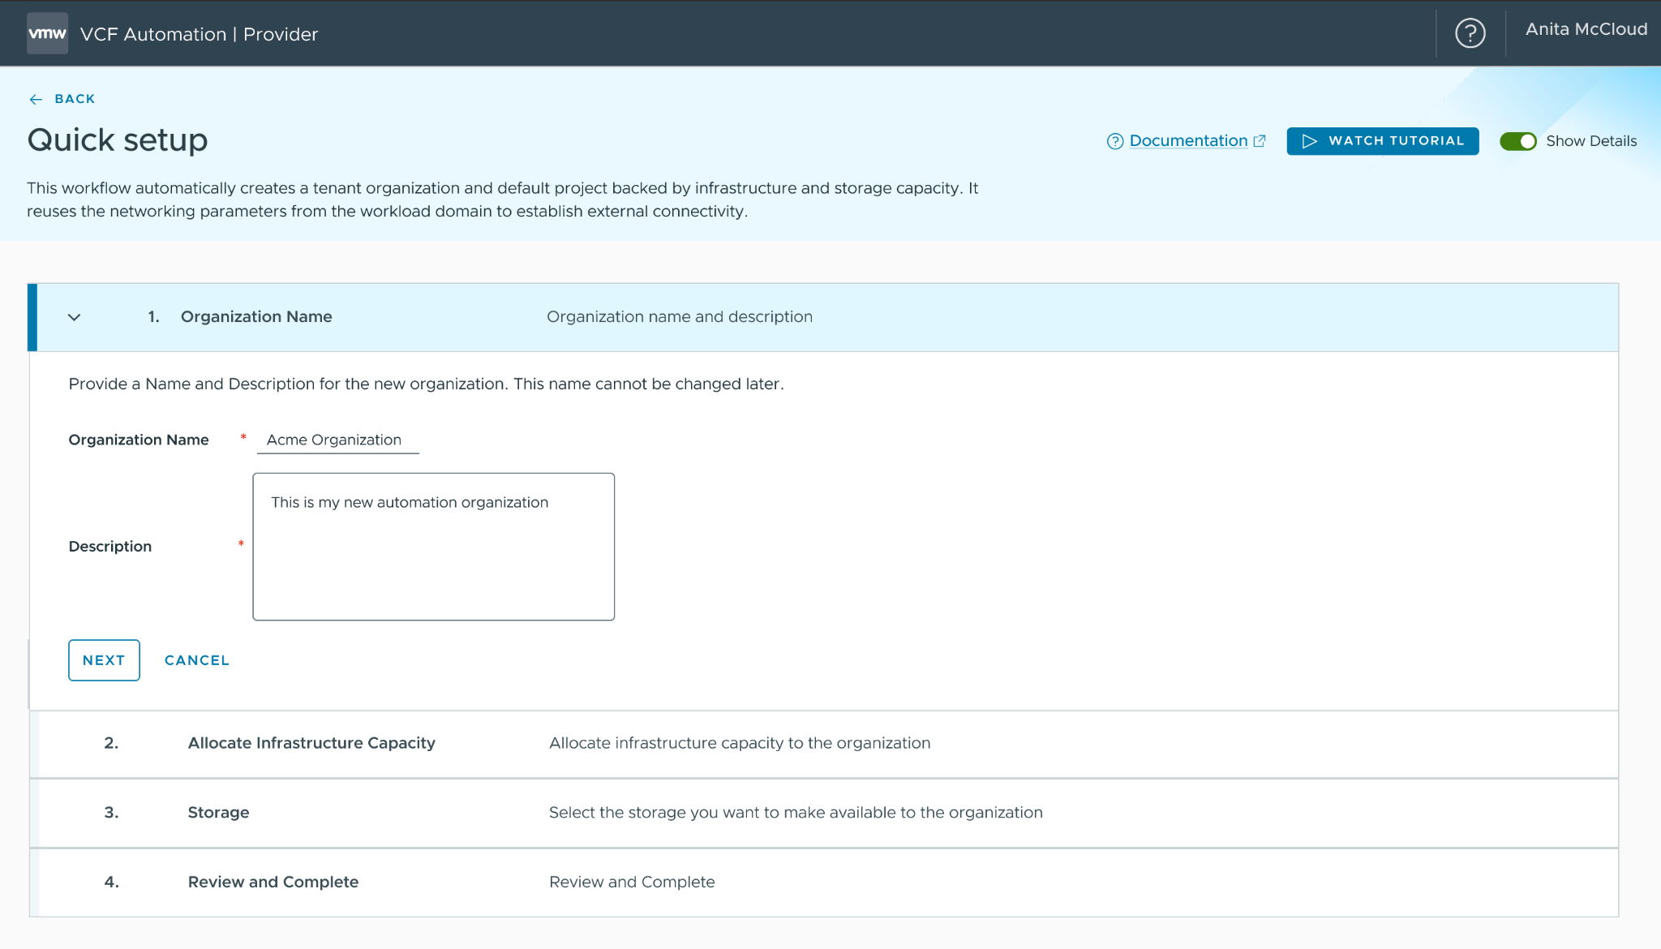
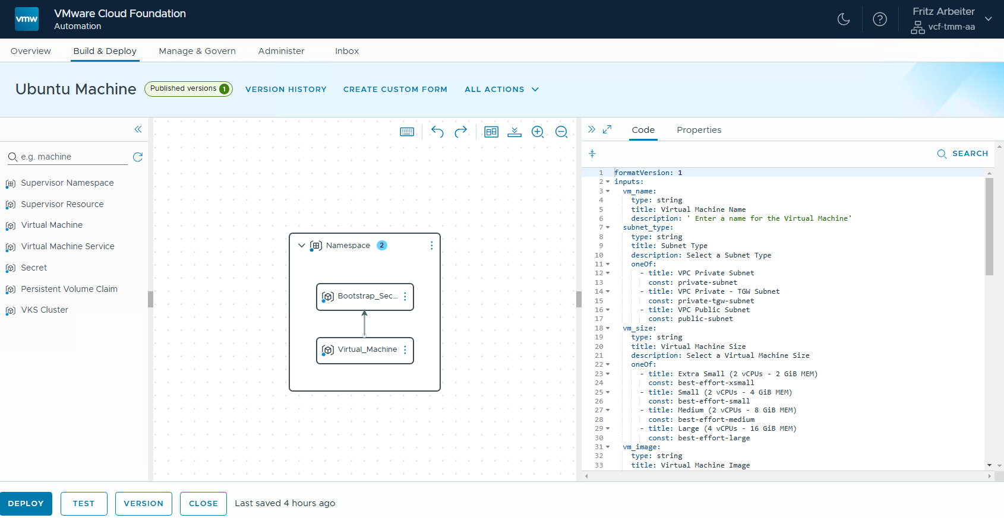
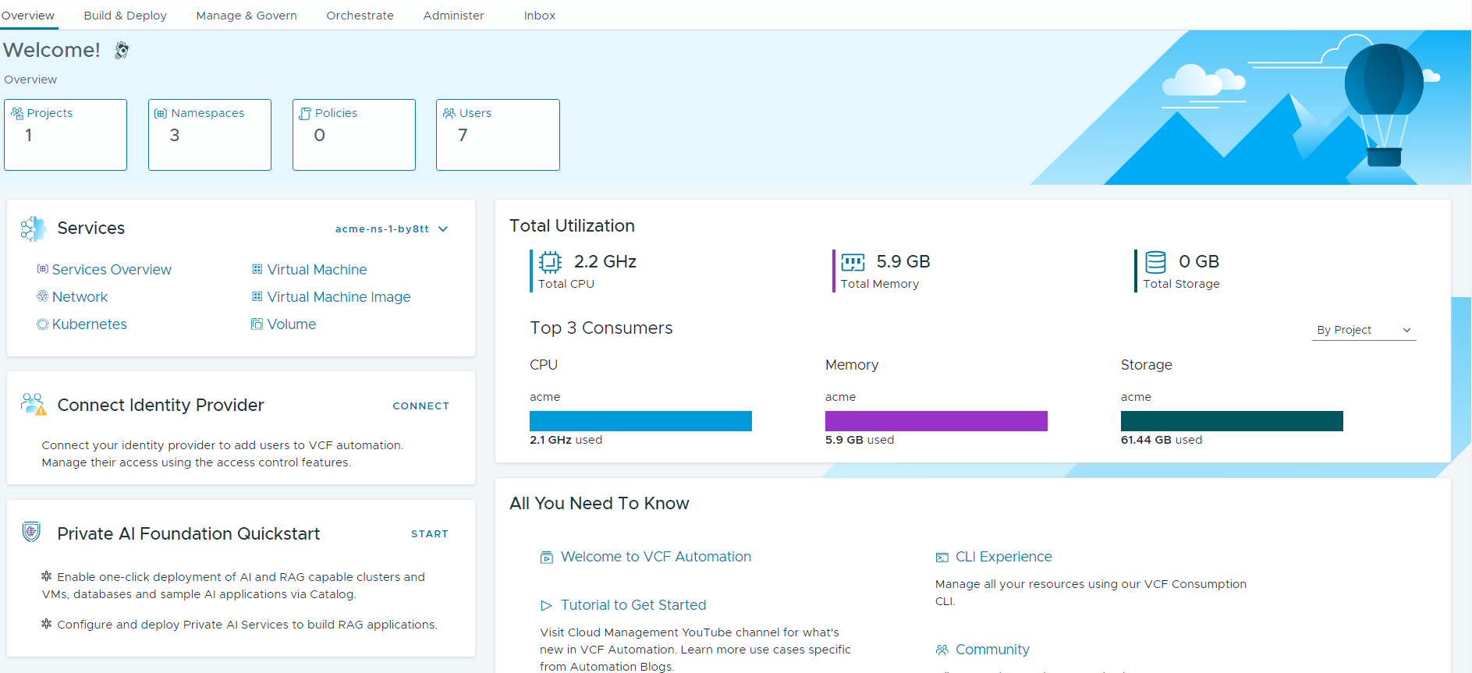
Streamlined Processes for Efficient Organization Management
Quick Setup and Guided Workflows to Configure Organizations
Simplify the adoption process for customers using VCF Automation 9, streamlining processes to save time, reduce errors, and boost productivity.
Enhance onboarding and support to create a better user experience.
Create organizations with network-isolated workloads and external connectivity through automated project and vSphere namespace creation.
Guided workflows assist users who opt out of the Quick Start.
Notes:
Presenter Note: This slide contains animation
Key Message:
With guided workflows in the quick setup, a customer can easily adopt VCFA 9 for the first time.
Talk Track:
With the Quick Setup feature, we have streamlined the process for IT Admins, enabling them to establish organizations more efficiently.
Instead of thinking about every detail from the beginning, they can start with a basic setup, with VCF Automation guiding IT Admins through the initial setup tasks.
The automatic creation of projects and vSphere namespaces by default accelerates the process of provisioning workloads almost immediately.
Additionally, having a default Virtual Private Cloud (VPC) setup establishes a network isolation domain within the organization, laying the groundwork for future scalability when multiple network isolation domains are needed.
<click>
When opting out of the Quick Setup, no configurations are set up. However, the product provides get-started guided workflows to assist in completing the necessary steps, which enhances organization onboarding and support.
These guided workflows can help to streamline the learning process, making it easier for administrators to understand and effectively utilize the system, ultimately leading to better user satisfaction and engagement.
Notes:
Customer Benefits:
The Quick Setup feature streamlines the process for IT Admins, enabling them to establish organizations more efficiently. Instead of thinking about every detail from the beginning, they can start with a basic setup, with VCF Automation guiding IT Admins through the initial setup tasks. This allows them to gradually gain proficiency and take on manual configurations as they become more familiar with the system.
Note: There is a Quick Setup at the Org level and that is the Quick Setup Wizard for Private AI but this is use-case specific (not everyone will have access).
So, one main benefits of providing guided workflows for users who opt out of the Quick Start and have no configurations is that it enhances user onboarding and support. These guided workflows can help to streamline the learning process, making it easier for users to understand and effectively utilize the system, ultimately leading to better user satisfaction and engagement.
When opting out of the Quick Start, no configurations are set up. However, the product provides guided workflows to assist in configuring the necessary resources.
Key Attributes:
Enterprise IT administrators can quickly move from zero to a fully functional organization capable of creating network-isolated workloads with external connectivity. The automatic creation of projects and vSphere namespaces by default accelerates the process of provisioning workloads almost immediately. Additionally, having a default Virtual Private Cloud (VPC) setup establishes a network isolation domain within the organization, laying the groundwork for future scalability when multiple network isolation domains are needed.
When opting out of the Quick Setup, no configurations are set up. However, the product provides guided workflows to assist in configuring the necessary resources.
Resources:

Slide 7
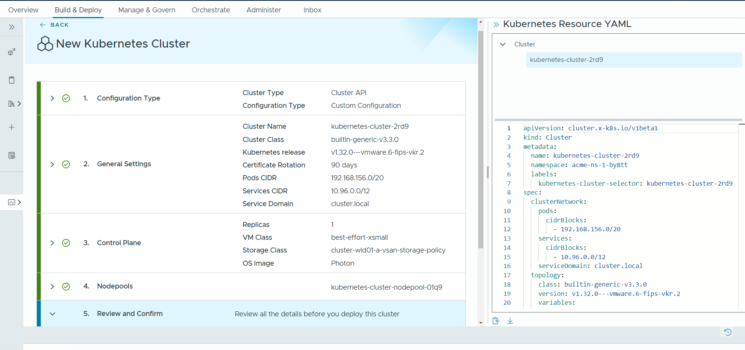
Provide Out-of-the-Box IaaS Services
Self-service cloud experience enabled by Supervisor Services
Simplify the deployment and management of IT resources.
Increase user productivity by reducing dependence on IT Admins.
User-friendly interface to save time and simplify operations.
Comprehensive OOTB IaaS services.
Public cloud-like experience.
Streamline provisioning of IaaS services with VCFA’s interface.
Notes:
Key Message:
With VCFA 9, we provide out-of-the-box Supervisor Services to simplify the deployment of IT resources while increasing user productivity by reducing the dependence on IT Admins with a time-saving user-friendly interface to simplify operations.
Talk Track:
With our comprehensive suite of out-of-the-box services (Core “VM, Kubernetes, Network, Volume” Extended “Data Services, Object Store Services” etc.), we simplify the deployment and management of IT resources.
This allows organizations to quickly scale their infrastructure needs, reduce operational complexities, and focus more on innovation and development rather than on maintaining disparate systems.
OOTB Supervisor services (Supervisor and associated services) are exposed across VCF environments and aggregated into a common endpoint that can be accessed through a choice of interfaces: UI, CLI, or the declarative Kubernetes IaaS API for self-service consumption.
Users can leverage a variety of Supervisor Services such as VM Service that allows you to declaratively define and provision VMs, VKS Service for deploying Kubernetes Clusters, Network Service to deploy Load balancers, Volume Service to deploy Persistent Volumes, Supervisor Services that help you extend the capabilities of the IaaS Platform like, Harbor for OCI Image registry, or Cert Manager for certificate management and the list can go on.
The Self-Service IaaS is an end-user-oriented approach. End users and app teams can freely consume the OOTB Supervisor services just like a public cloud for maximum productivity and efficiency.
End users and app teams can deploy and manage VMs alongside Kubernetes clusters and other vSphere-based resources using a unified management experience.
Notes:
Customer Benefits:
Offer a comprehensive suite of out-of-the-box services (VM, Kubernetes, Network, Volume, Data Services, Object Store Services etc.), which simplifies the deployment and management of IT resources. This allows organizations to quickly scale their infrastructure needs, reduce operational complexities, and focus more on innovation and development rather than on maintaining disparate systems.
Increase end-user satisfaction & productivity – they can get the infrastructure they need when they need it, the way they want it, and w/out having to rely on or wait for other teams.
Leveraging a unified management interface means having a streamlined and user-friendly platform to oversee all Infrastructure as a Service (IaaS) offerings. This can enhance efficiency by reducing the complexity of managing multiple services separately. Customers can expect to easily deploy, monitor, and scale their infrastructure resources from one central location, which saves time and simplifies operations. Additionally, this unified approach can lead to better resource allocation and cost management, ultimately contributing to a more effective use of their IT investments.
Key Attributes:
OOTB Supervisor services (Supervisor and associated services) are exposed across VCF environments and aggregated into a common endpoint that can be accessed through a choice of interfaces: UI, CLI, or the declarative Kubernetes IaaS API for self-service consumption. Users can leverage a variety of Supervisor Services such as VM Service that allows you to declaratively define and provision VMs, VKS Service for deploying Kubernetes Clusters, Network Service to deploy LBs, Volume Service to deploy Persistent Volumes, Supervisor Services that help you extend the capabilities of the IaaS Platform (e.g., Harbor for OCI Image registry, or Cert Manager for certificate management) and the list can go on.
Self-Service IaaS is an end user-oriented approach, which is ideal for dev/test environments, where end users and app teams can freely consume the OOTB Supervisor services just like a public cloud for maximum productivity and efficiency.
End users and app teams deploy and manage VMs alongside Kubernetes clusters and other vSphere-based resources using a unified management experience.
Resources:

Slide 8
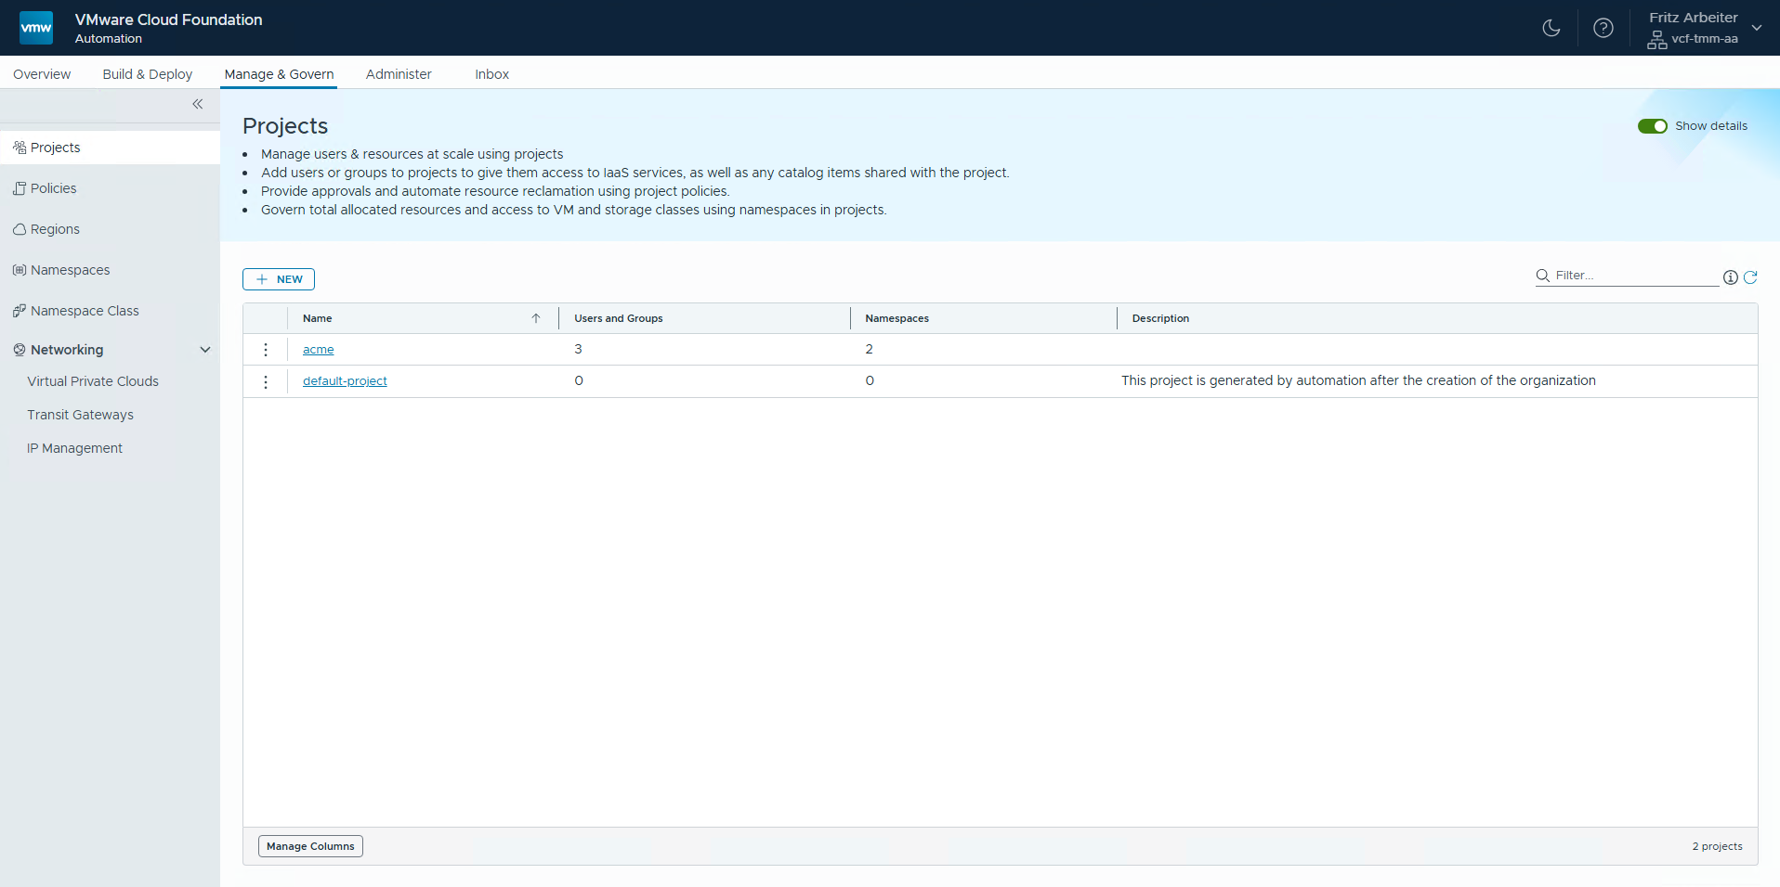
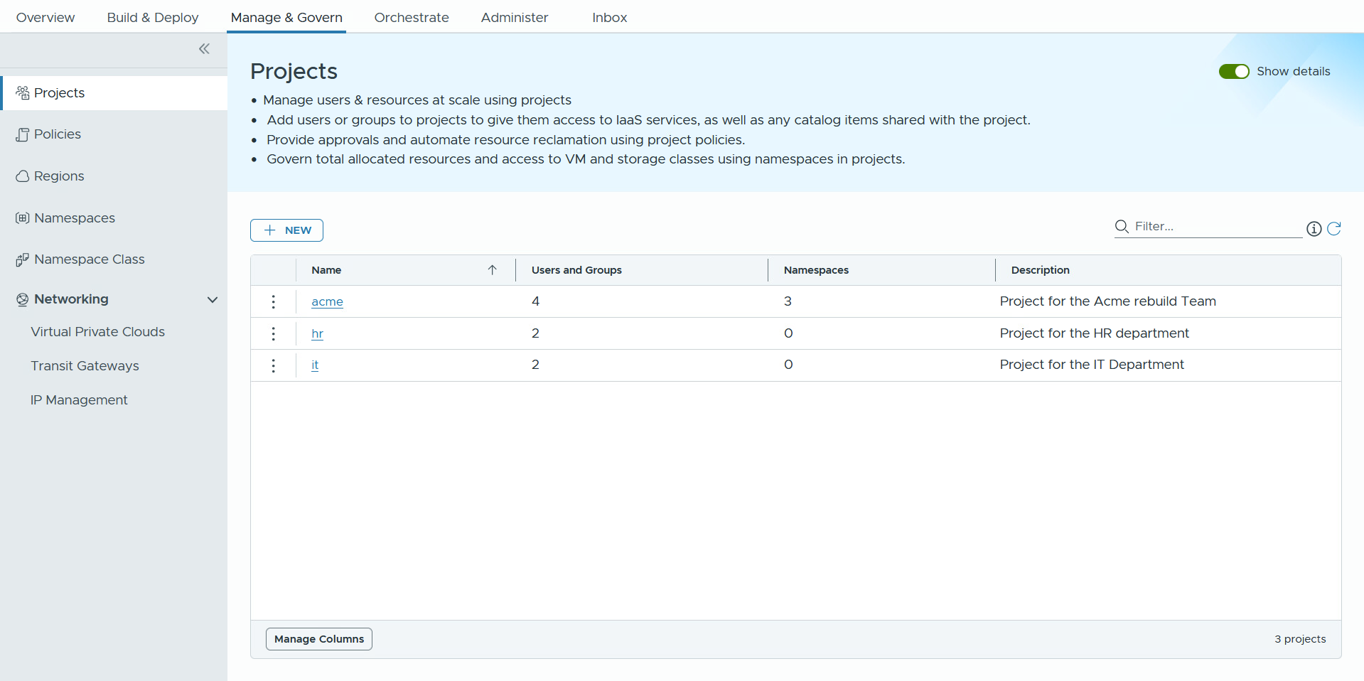
Balancing Access and Efficiency for Optimal Resource Management
Governance for users and resources with Limits and Reservations.
Enhance efficiency and streamline processes of infrastructure resources.
Achieve control over resources, cost, scaling, and overall operational performance.
Organization Admins can create projects and vSphere Namespaces, assign users, and view usage/costs.
A vSphere Namespace is a resource pool that facilitates IaaS provisioning by providing a framework through the vSphere Namespace class.
Notes:
Key Message:
Each org can have specific infrastructure quotas for their region. Orgs enjoy complete network and computing isolation, which means they are entirely separate from one another. This setup makes Org Admins feel like they have their own private cloud, even though the Enterprise IT Admin manages shared VCF vCenter resources in the background. The Org Admin can log into their own portal to create PROJECTS and assign it to different LOBs. In each project, Org Admins can create IaaS NAMESPACES, which define application boundaries, limits on infrastructure use, and reservations so end-users and application teams can easily access modern IaaS services. Each vSphere Namespace can be under an isolated networking domain (VPC).
Talk Track:
With governance for users and resources, IT Admins can enable effective resource management through capabilities like reservations and limits, ensuring that critical applications receive the necessary resources while avoiding over-provisioning, which leads to cost savings.
Organization Admins can create and manage multiple projects while assigning specific users to each project (LOBs).
After the creation of a project, vSphere Namespaces can be created.
Org Admins can create and configure namespaces, with namespace classes, to set quotas, reservations, content libraries, and Virtual Private Clouds (VPC).
The vSphere Namespace is an advanced resource pool that provides features such as utilization, reservations, limits, and the ability to provision various IaaS Services.
The Namespace class is a template that can be tailored based on the specific needs of the namespace, whether they are small, medium, or large. It enforces limits on resource consumption to prevent individual users from monopolizing resources, especially in multi-tenant environments.
Org Admins can also gain insights into utilization at the organizational, project, vSphere Namespace, and infrastructure level (VM and VKS clusters).
Also, Org admins can view costs at the organizational level, region quota, and namespace levels.
Notes:
Customer Benefits:
Establishing a well-defined distribution of infrastructure resources, including quotas and policies, for each application team is essential. This approach not only fosters accountability and clarity among teams but also ensures that resources are utilized effectively, promoting collaboration and reducing potential conflicts over resource allocation. By doing so, Org Admins can enhance overall productivity and allow each app team to focus on their specific goals with the necessary support.
Enable effective resource management through capabilities like reservations and limits, ensuring that critical applications receive the necessary resources while avoiding over-provisioning, which leads to cost savings. The flexibility to customize namespace classes allows for efficient scaling to meet changing business demands.
Key Attributes:
Org Admins can create and manage multiple projects while assigning specific users to each project (LOBs). Org Admins can also gain insights into utilization and costs at the organizational, project, and vSphere Namespace levels. During the creation of a project, vSphere Namespaces can be dynamically created and attached. Org Admins can customize namespaces by setting quotas, reservations, content policies, and Virtual Private Clouds (VPC).
The vSphere Namespace is an advanced resource pool that provides features such as utilization, reservations, limits, and the ability to provision various IaaS Services. The Namespace class is a template that can be tailored based on the specific needs of the namespace, whether they are small, medium, or large. It enforces limits on resource consumption to prevent individual users from monopolizing resources, especially in multi-tenant environments. The built-in reservations ensure guaranteed resource availability for critical applications, while quotas help control resource usage and spending, aligning with organizational policies.
Resources:

Slide 9
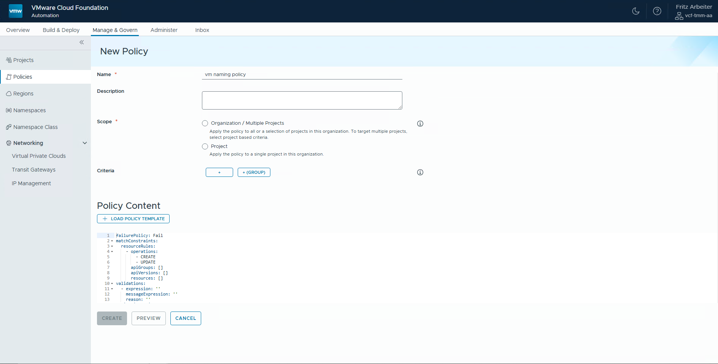
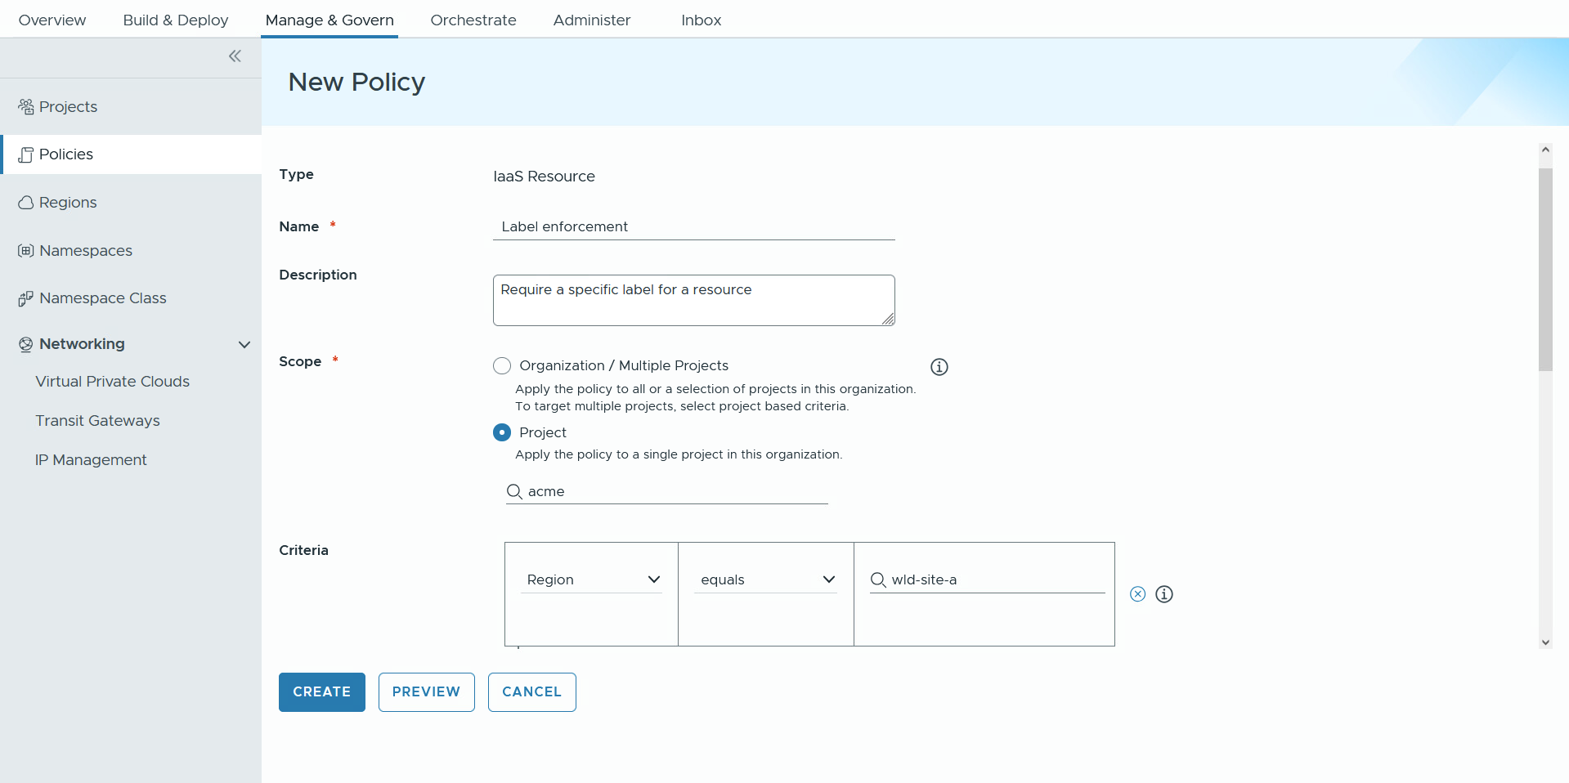
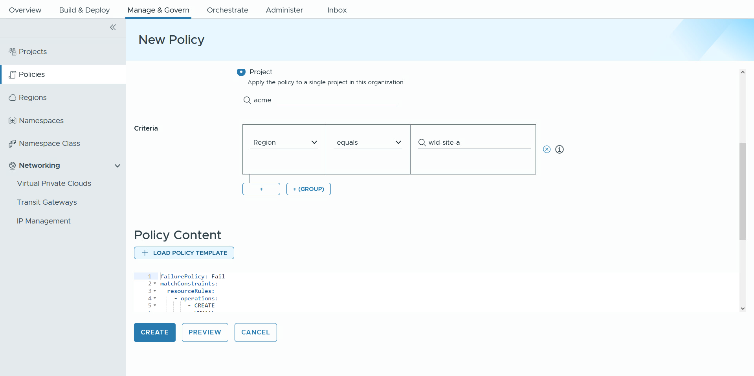
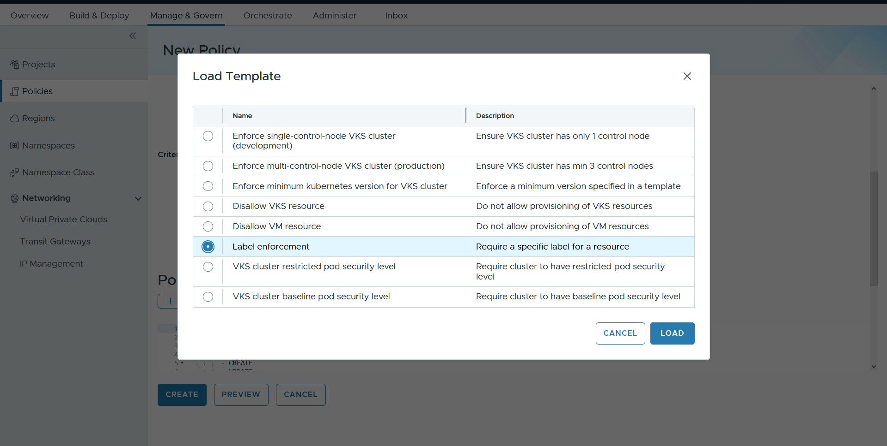
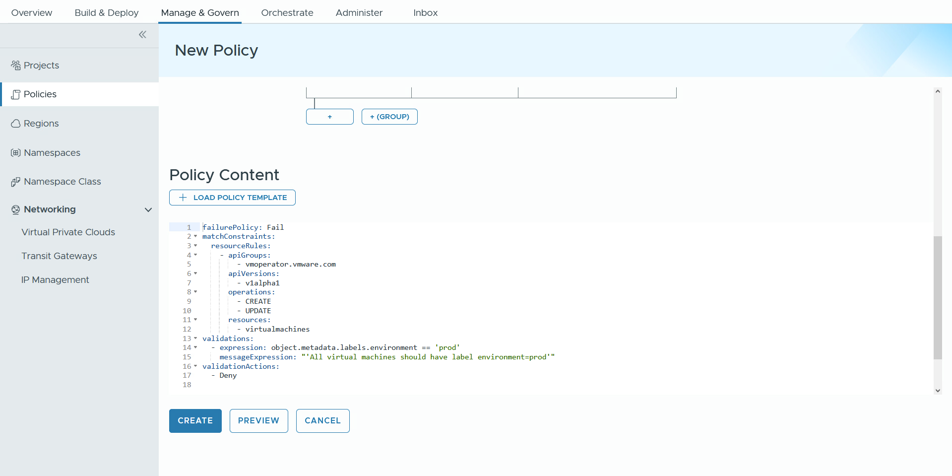

Enforce Best Practices for Resource and Security Configurations
Implement resource policies with Policy as Code.
Create a secure, compliant, and efficient cloud infrastructure while empowering teams with the tools they need to manage policies.
An effective policy management process enables customers to focus on innovation and core business activities.
Flexible framework for implementing IaaS and Kubernetes policies.
OOTB templates for day 0 Kubernetes and VM policies
Notes:
Presenter Note: This slide contains animation.
Key Message:
With VCFA 9 you can implement resource policies with policies-as-code to enforce bast practices for your resources and apply security configurations.
Talk Track:
With VCF Automation 9 you can implement a YAML-based approach to policy as code to enforce best practices for your resources and apply security configurations.
Let’s scroll down to view the policy as code.
<click 1>
and click Load Policy Template.
<click 2>
The pre-defined OOTB templates are designed to streamline the implementation of policies as code for both initial setup (day 0) and ongoing management (day 2) of Kubernetes and VM environments. These templates serve as a solid foundation, allowing users to easily customize and fine-tune their policies through a user-friendly interface or directly via the Kubernetes command-line interface (CLI), ensuring a tailored approach to meet specific operational needs.
With Label enforcement selected click load.
<click 3>
In this example we are enforcing the label prod is applied to all virtual machine resources.
Notes:
Customer Benefits:
Using a YAML-based Policy-as-Code framework with Kyverno for IaaS and Kubernetes offers multiple benefits, including flexibility in adapting policies, automation for consistent enforcement, and improved compliance with security and regulatory standards. It fosters collaboration within the open-source community, enables easy tracking of policy changes through version control, and provides clarity for auditing. Additionally, leveraging an open-source solution helps reduce licensing costs, ultimately enhancing security, compliance, and efficiency in cloud infrastructure.
Customers benefit from pre-defined Out-of-the-Box (OOTB) templates through quick deployment, easy customization, and best practice integration. These templates ensure consistency, reduce complexity, enhance agility, and improve governance, enabling organizations to focus on innovation.
Key Attributes:
Introducing new governance policies that leverage a YAML-based approach to policy as code. To support this initiative, we are using Kyverno, an open-source technology that operates on the backend, enabling us to seamlessly integrate and enforce these policies in a robust and efficient manner.
Resources:

Slide 10
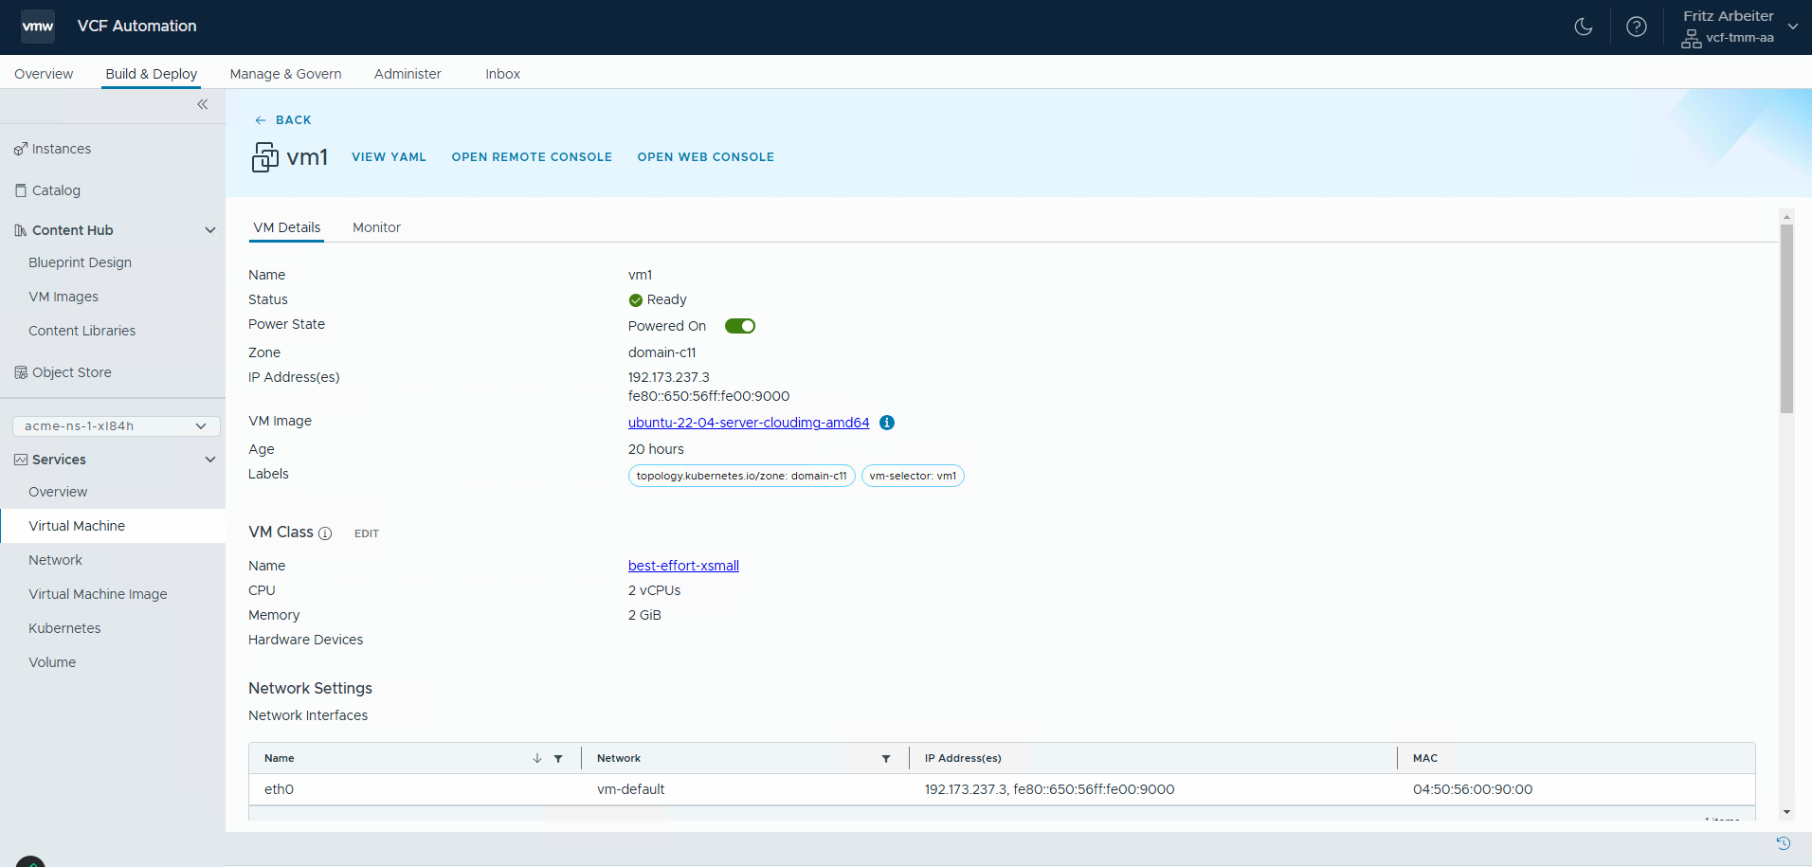
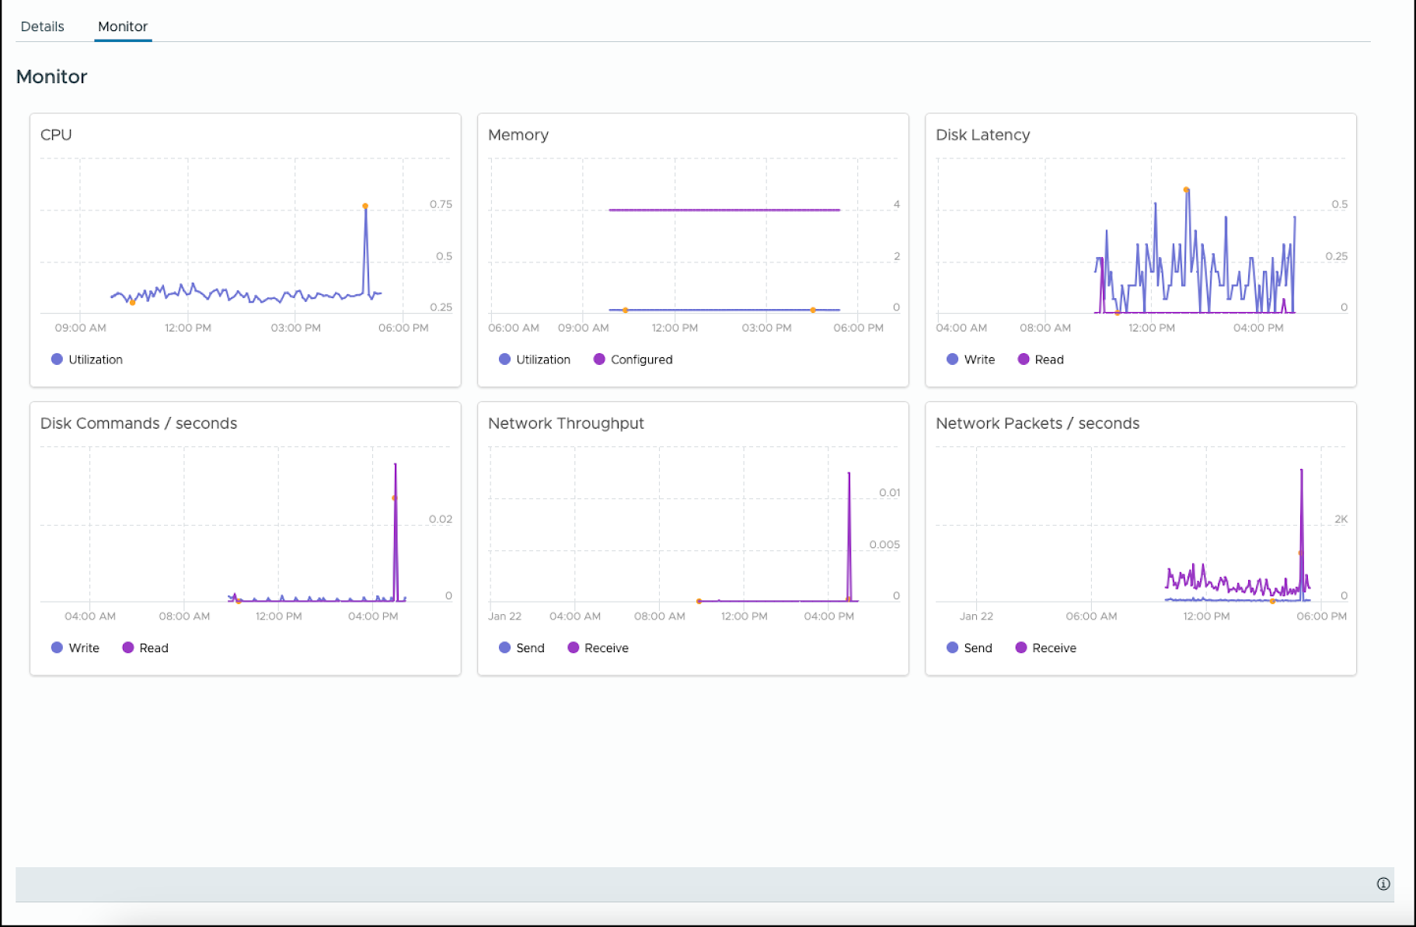
Application Operations visibility
VMs and Kubernetes Services
Rich set of metrics for VMs and K8s clusters that can be accessed directly by end-users and developers
VM – Utilization metric for CPU, Mem, Disk IOPS and Network throughput
K8s cluster – K8s version, Utilization metrics for CPU, Memory
Visibility for End users and Developers, not just Admin
Notes:
Presenter Note: This slide contains animation.
Key Message:
Features:
Rich set of metrics for VMs and K8s clusters that can be accessed directly by end-users and developers
VM – Utilization metric for CPU, Mem, Disk IOPS and Network throughput
K8s cluster – K8s version, Utilization metrics for CPU, Memory
Benefits:
Visibility for End users and Developers, not just Admin
Talk Track:
With VCF Automation and Operations, end-users and developers can easily review a rich set of metrics for VMs and K8s clusters.
<click>
These metrics for VMs include utilization for CPU, memory, disk IOPS, and Network throughput. For Kubernetes clusters, users can review the Kubernetes version and utilization metrics for CPU and memory consumption.

Slide 11
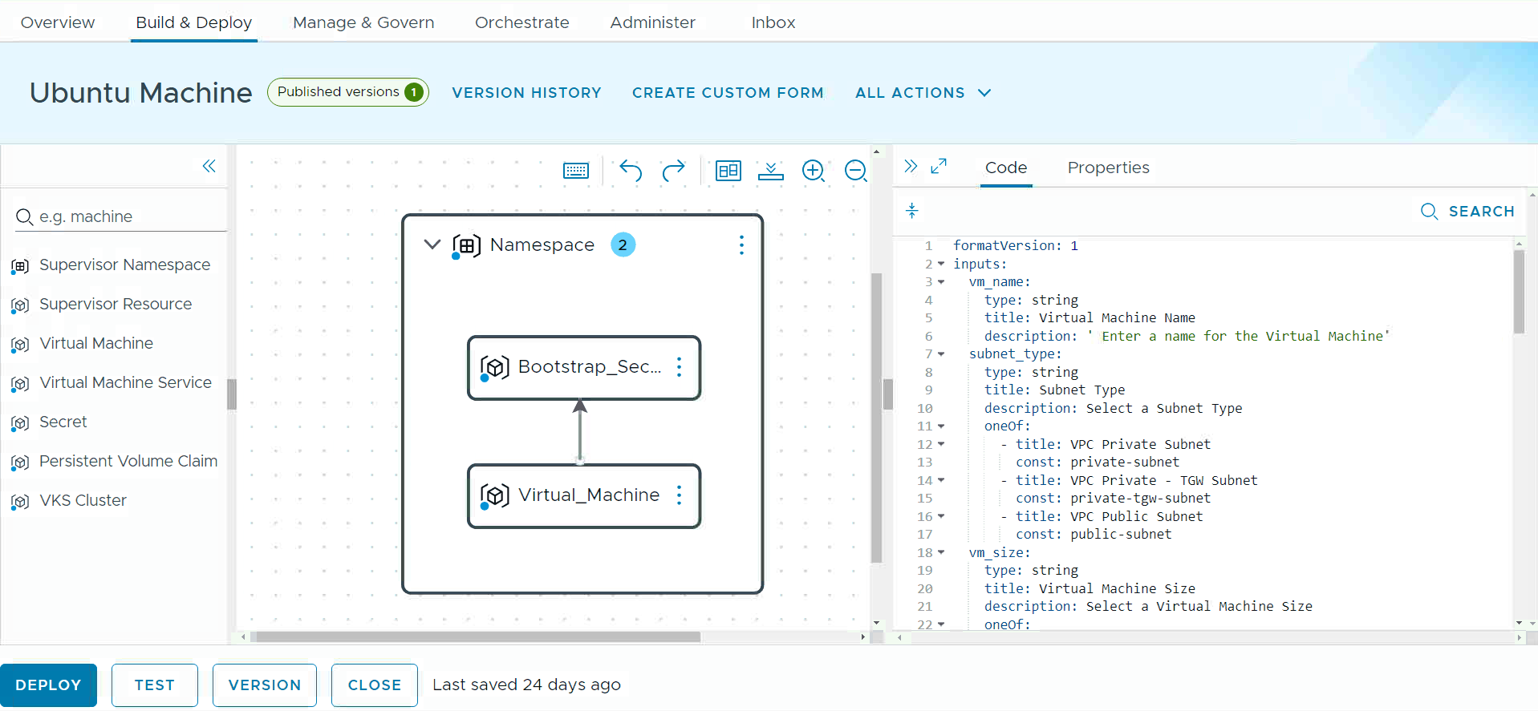
Enforce Infrastructure Governance and Enable Self-service
Provide custom blueprint development for tailored IaaS services
Implement controls to enhance security and efficiency for reduced downtime
Accelerate app development and reduce time-to-market
Self-Service Catalog Experience:
Provide curated catalog items based on IaC templates
Facilitate the creation of customized IaaS services and publish them to the catalog, as needed
Notes:
Key Message:
With VCFA 9 customers can create custom blueprints tailored to IaaS Services, while enforcing infrastructure governance and enabling self-service consumption.
Talk Track:
One benefit of allowing Enterprise IT Admins to have more control in production environments is enhanced security. With increased control, admins can implement stricter access controls, monitor system activities more closely, and enforce compliance with organizational policies, reducing the risk of unauthorized access or data breaches; ideal for in-production environments.
Providing application teams more flexibility to consume self-service IaaS resources accelerates development and testing cycles. By allowing teams to quickly provision and configure the necessary infrastructure on demand, they can focus more on writing and testing code rather than waiting for resources, leading to faster time-to-market for new features and enhancements.
The catalog experience allows users to provision traditional, modern, and generative AI applications. Each catalog item is supported by blueprints developed and published for the project teams.
Using the design canvas, advanced users can create on-demand resources like VMs, Kubernetes, volumes, networks, and storage from scratch and publish them in the catalog.
Notes: Customer Benefits:
One benefit of allowing Enterprise IT Admins to have more control in production environments is enhanced security. With increased control, admins can implement stricter access controls, monitor system activities more closely, and enforce compliance with organizational policies, thereby reducing the risk of unauthorized access or data breaches; ideal for in-production environments.
One benefit of providing application teams with more flexibility to consume self-service IaaS resources is the acceleration of development and testing cycles. By allowing teams to quickly provision and configure the necessary infrastructure on-demand, they can focus more on writing and testing code rather than waiting for resources, leading to faster time-to-market for new features and enhancements.
Key Attributes:
The catalog experience allows users to provision traditional, modern, and generative AI applications. Each catalog item is supported by templates that have been developed and published for the project teams. It is designed for low-tech users to easily utilize the templates provided in the catalog.
Create on-demand resources like VMs, Kubernetes, volumes, networks, and storage. This is ideal for high-tech users who wish to utilize the design canvas to create resources from scratch and publish them in the catalog. Resources:

Slide 12
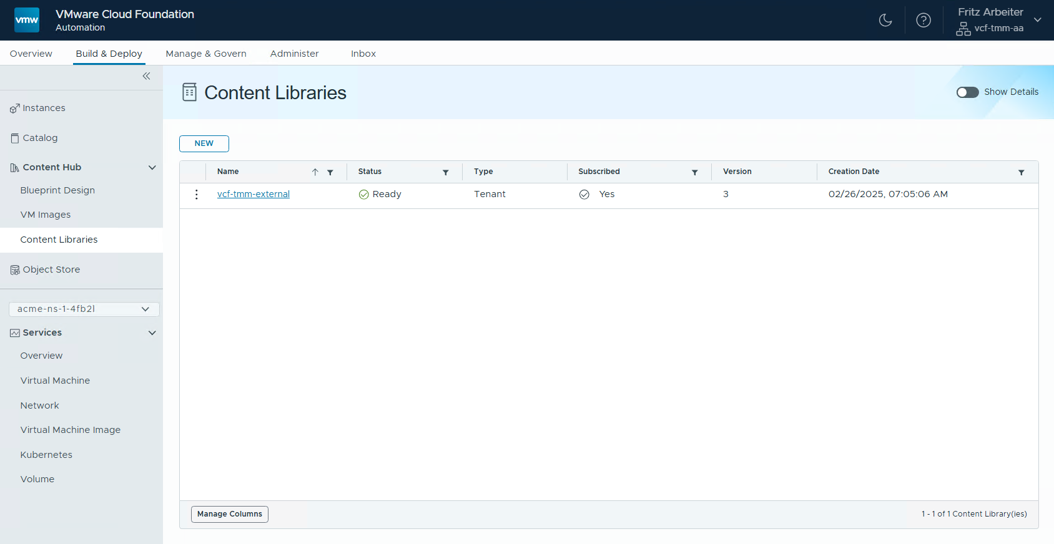
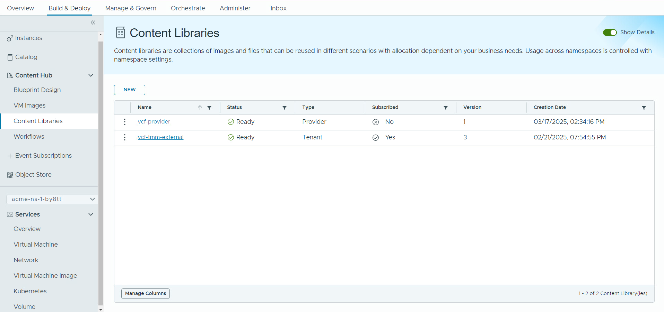
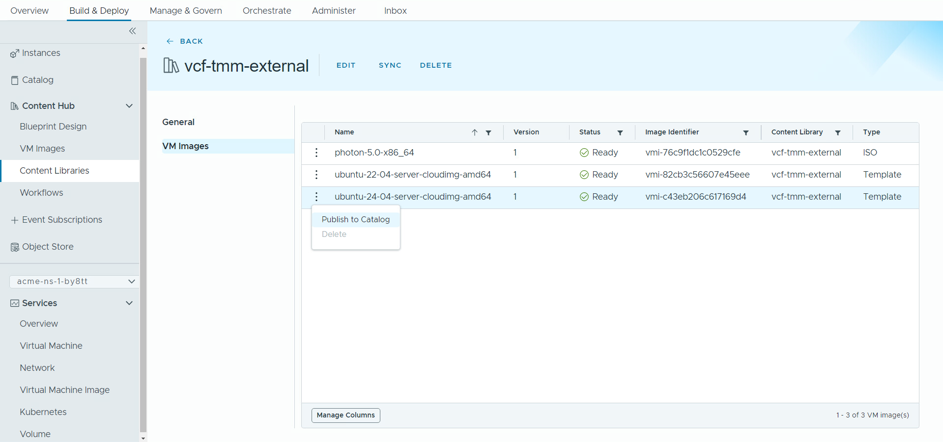
Simplify the Content Management Experience
Centralize content management via Content Hub.
Streamline the overall content management process
Boost productivity and collaboration with a unified content portal
Discover vCenter content libraries automatically and allocate new or existing libraries to one or more organizations
Publish content to the self-service catalog with one click
Create orchestrator workflows in VCFA that can be easily published to the catalog
Notes:
Presenter Note: This slide contains animation
Key Message:
With centralized content management via the content hub, customers can streamline the overall content management process while improving productivity and collaboration with a unified content management portal.
Talk Track:
Centralized content management enables IT Admins to easily discover, create, and allocate content libraries directly within VCFA, reducing complexity, minimizing errors, and streamlining the overall management process. This leads to increased efficiency and better resource allocation for customers.
Before the introduction of VCF 9.0, managing the content library across multiple vCenters and data centers involved a “publish and subscribe” model. In this model, one vCenter acted as the publisher, hosting the content library, while the other vCenters served as subscribers. This setup, known as "pub and sub," could become quite complicated, especially with many vCenters across multiple data centers, leading to significant challenges in synchronizing content libraries.
With VCF 9.0, we consolidate content library management within VCF Automation by connecting to all vCenters to discover all content libraries. This process allows the IT Admin to allocate a content library to one or all organizations. VCF Automation automatically synchronizes these libraries with the vCenters in the background.
In VCF 9.0, you can also create a new content library directly within VCF Automation, add one or more VM images, and allocate the library to one or more organizations, as needed. All of these tasks can be accomplished within VCF Automation without relying on the previous "pub and sub" model, simplifying management and eliminating associated complexities.
Another important feature to note is that users can leverage the same content library across multiple vCenters via Regions; it’s a cool feature that a lot of customers identified as missing from the vCenter content library that VCFA currently provides.
<click 1>
Org Admins can publish content to the self-service catalog with a single, easy click. This streamlined process allows them to make resources readily available to end-users and app teams, empowering them to access and utilize the content efficiently.
<click 2>
The Content Hub Management was explicitly designed for Org Admins and Line of Business (LOB) teams to efficiently manage a wide array of resources. This includes content libraries, virtual machine (VM) images, blueprints, and orchestrator workflows. Users can seamlessly organize and maintain these resources in one location, simplifying the process of sharing them across multiple projects.
Notes:
Customer Benefits:
Centralized content management enables IT Admins to easily discover, create, and allocate content libraries directly within VCFA, reducing complexity, minimizing errors, and streamlining the overall management process. This leads to increased efficiency and better resource allocation for customers.
By consolidating the IT Admin published content and the Org Admin created/imported content in one place, VCFA simplifies the process of sharing the resources across various projects. This enhances collaboration among team members and ensures that everyone has quick access to the necessary tools and assets, which ultimately improves project execution and boosts overall productivity.
The ability for Org Admins to publish content to the self-service catalog streamlines access to resources by allowing quick publication with a single click. This enables end-users and app teams to independently consume resources without waiting for approvals. This empowerment fosters innovation and boosts productivity while allowing Org Admins to efficiently manage and update content, ensuring end users/app teams have access to the latest information.
Improved user experience by integrating the Orchestrator UI into the VCFA UI under the Orchestrate tab, making it easier to navigate and reducing the need for a separate interface. This streamlines workflow creation and management in a consistent environment.
Key Attributes:
All existing customers utilize the vCenter content library for VM image management. Before the introduction of VCF 9.0, managing the content library across multiple vCenters and data centers involved a “publish and subscribe” model. In this model, one vCenter acted as the publisher, hosting the content library, while the other vCenters served as subscribers. This setup, known as "pub and sub," could become quite complicated, especially with many vCenters across multiple data centers, leading to significant challenges in synchronizing content libraries. With VCF 9.0, we are consolidating content library management within VCFA. In VCFA, we connect to all vCenters to discover all content libraries. This process allows the IT Admin to allocate a content library to one or all organizations. VCFA automatically synchronizes these libraries with the vCenters in the background, streamlining the process. In VCF 9.0, you can also create a new content library directly within VCFA, add one or more VM images to this library, and allocate it to one or more organizations, as needed. All of these tasks can be accomplished within VCFA without relying on the previous "pub and sub" model, simplifying management and eliminating associated complexities. Another important feature to note is that users can leverage the same content library across multiple vCenters via Regions; it’s a cool feature that a lot of customers identified as missing from the vCenter content library that VCFA currently provides.
The Content Hub Management was designed specifically for Org Admins and Line of Business (LOB) teams to efficiently manage a wide array of resources. This includes content libraries, virtual machine (VM) images, blueprints, and orchestrator workflows. Users can seamlessly organize and maintain these resources in one location, simplifying the process of sharing them across multiple projects.
Resources:

Slide 13
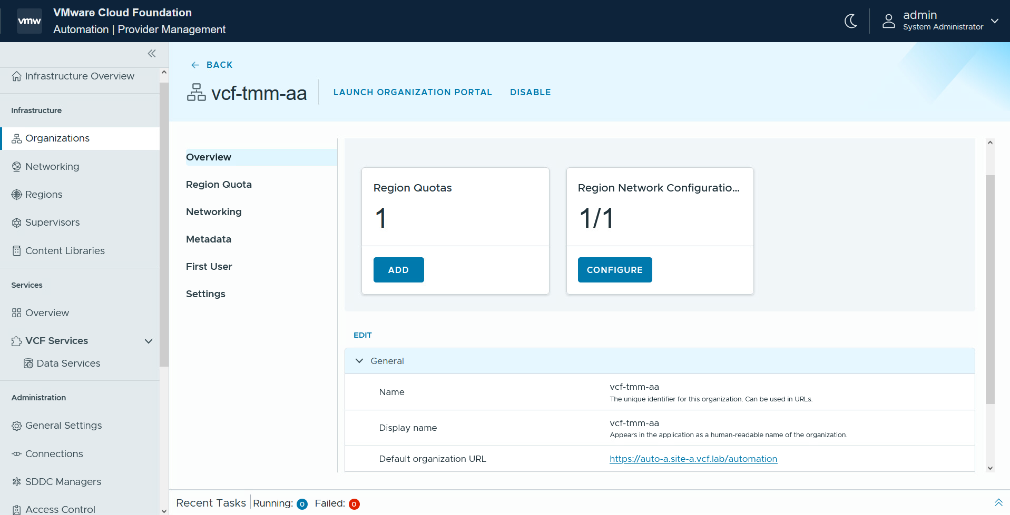
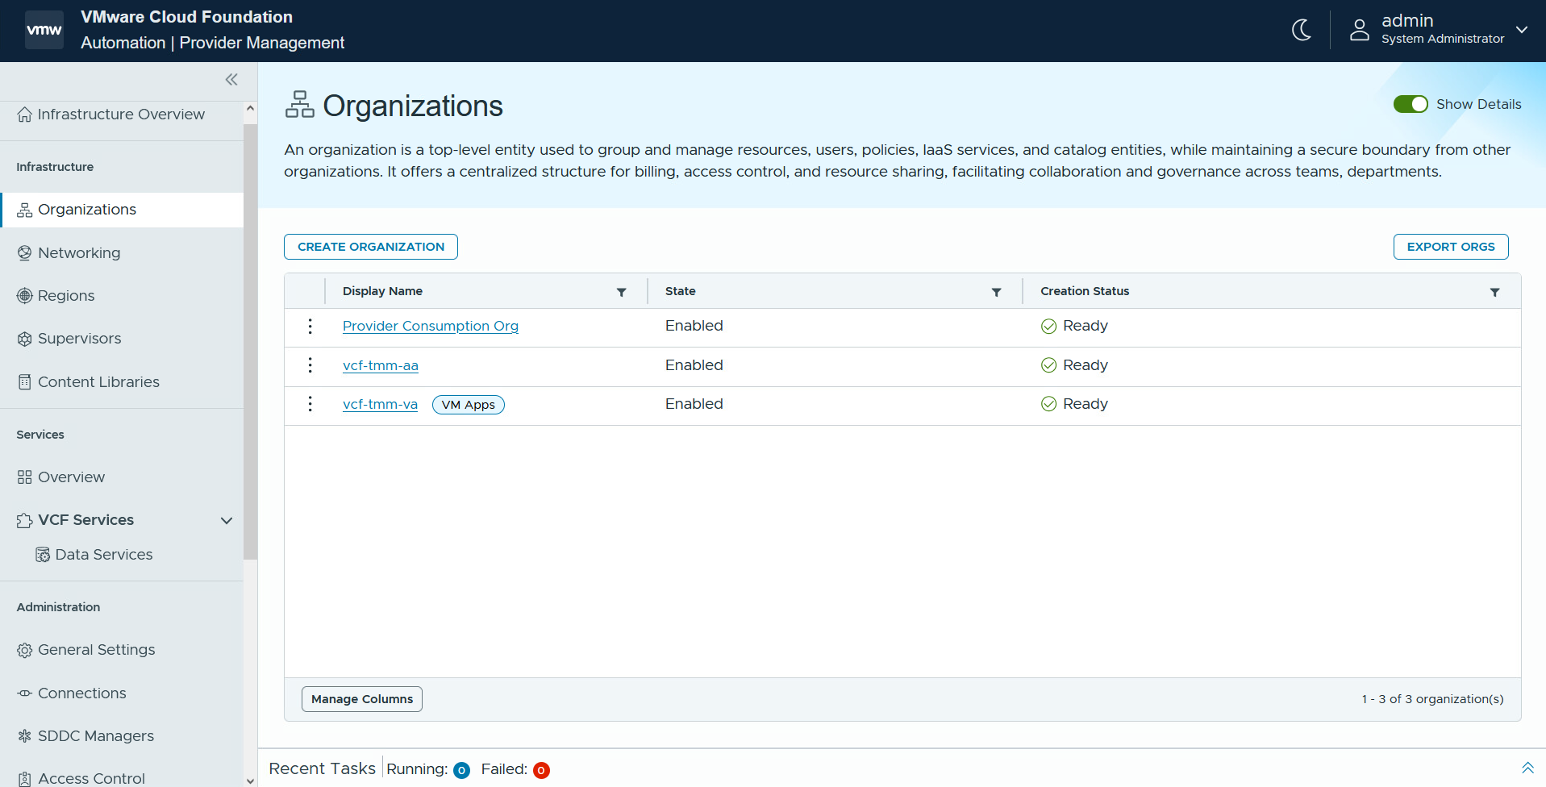
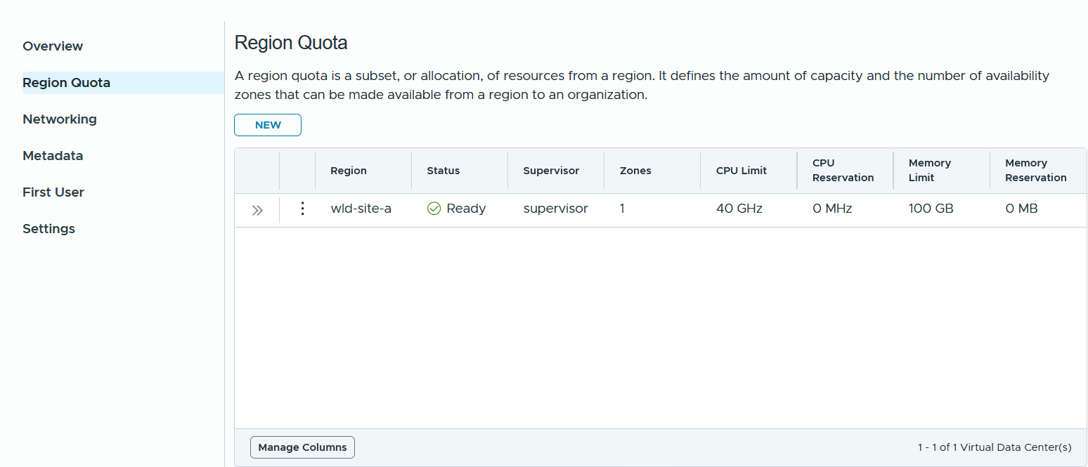
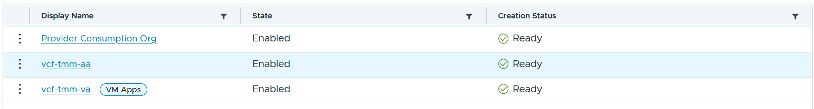
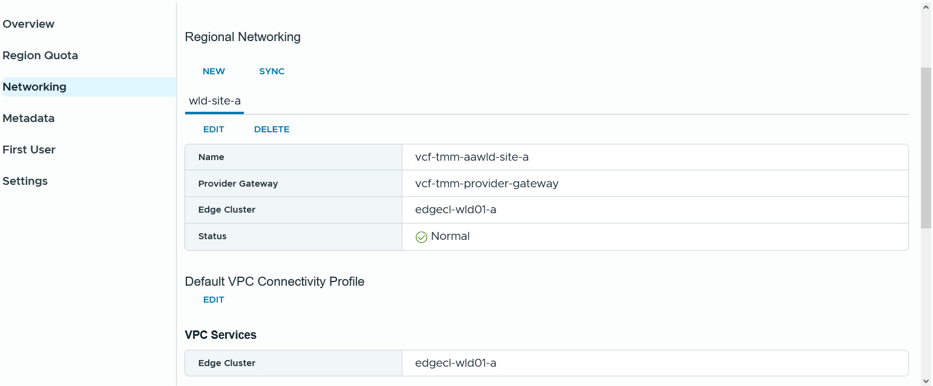
Build a Secure, Compliant and Efficient Private Cloud
Streamline organizational resource management and operations
Highly available and fault tolerant
Comprehensive network isolation
Extensible services ecosystem.
Increased visibility and control:
Application teams can choose multiple vSphere zones for deploying applications
Organizations have separate resources and use VPCs to isolate teams in those organizations
Manage resources, set quotas, control permissions, and offer managed services like encryption and backup
Notes:
Presenter Note: This slide contains animation.
Key Message:
VCF Automation enables single or multi-tenant private clouds, allowing IT Admins to allocate resources to organizations, each managing users and resources specific to their group. The first step in building a private cloud is to break down a shared infrastructure into individual segments and allocate these segments to different organizations. This approach ensures that each organization feels isolated from the others while allowing for secure and efficient use of resources tailored to their specific needs.
Talk Track:
With VCF Automation 9, you can empower application teams by allowing them to select multiple vSphere zones to deploy their applications. This flexibility enables teams to optimize resource utilization, enhance application performance, and ensure redundancy across different zones, improving the reliability and scalability of their deployments.
By ensuring organization isolation at the networking level and aligning with NSX tenancy constructs, we provide comprehensive network isolation throughout the stack while guaranteeing immediate internal and external connectivity upon the creation of the organization.
IT administrators can also provide organizations with a comprehensive Private Cloud experience supported by an extensible managed services ecosystem from VMware and partner services.
Enhanced visibility and control are achieved by providing deeper insights into the consumption of cloud infrastructure through chargeback and showback methods. This approach allows for more informed decision-making and proactive resource management. Furthermore, implementing policy-based controls can reduce costs by optimizing resource utilization and minimizing operational expenses. These controls effectively manage consumption, prevent over-provisioning, and help eliminate unnecessary costs.
<click 1>
<click 2>
A Supervisor can be deployed on three vSphere Zones to provide clusters with high availability and fault tolerance, essential for building highly reliable applications.
<click 3>
First, ensure that each organization is isolated from the others regarding networking and computing resources. Next, establish network isolation for different application teams within each organization using Virtual Private Clouds (VPCs). Finally, implement a transit gateway to facilitate communication between VPCs and to enable connectivity with external networks outside the organization.
<click 4>
Enterprise IT admins manage resources and set quota policies for each organization. They control identity, permissions, and operations, and they organize content management across different LOBs. Additionally, IT admins can provide various managed services such as encryption, backup, and data management using services created by VMware and third-party software vendors (e.g., Veeam for backup services).
Enterprise IT Admins gain insight into resource utilization, costs, and spending across different orgs, environments, and workload types. After establishing orgs and defining quota limits and networking configurations, providers can utilize operations to thoroughly assess each org's resource usage and implement chargeback mechanisms. Additionally, if desired, custom branding can be created for each org console within VCF Automation, allowing for a distinct branding experience for each org.
Notes:
Customer Benefits:
With VCFA 9 you can empower application teams by allowing them to select multiple vSphere zones for the deployment of their applications. This flexibility will enable teams to optimize resource utilization, enhance application performance, and ensure redundancy across different zones, ultimately improving the reliability and scalability of their deployments.
By ensuring org isolation at the networking level and aligning with NSX tenancy constructs, we provide comprehensive network isolation throughout the stack while guaranteeing immediate internal and external connectivity upon the creation of the organization.
Improved compliance and security measures ensure consistent policy enforcement across LoBs, minimizing human error while adhering to organizational and regulatory standards. IT administrators can also provide orgs with a comprehensive Private Cloud experience supported by an extensible managed services ecosystem from VMware and partner services.
Enhanced visibility and control are achieved by providing deeper insights into the consumption of cloud infrastructure through chargeback and showback methods. This approach allows for more informed decision-making and proactive resource management. Furthermore, implementing policy-based controls can lead to cost reductions by optimizing resource utilization and minimizing operational expenses. These controls effectively manage consumption, prevent over-provisioning, and help eliminate unnecessary costs.
Key Attributes:
A Supervisor can be deployed on three vSphere Zones to provide clusters with high availability and fault tolerance, which are essential for building highly reliable applications.
First, ensure that each organization is isolated from one another in terms of networking and computing resources. Next, establish network isolation for different application teams within each organization by using Virtual Private Clouds (VPCs). Finally, implement a transit gateway to facilitate communication between VPCs and to enable connectivity with external networks outside the organization.
Enterprise IT admins manage resources and set quota policies for each org. They control identity, permissions, and operations, and they organize content management across different LOBs. Additionally, IT admins can provide various managed services such as encryption, backup, and data management using services created by VMware and third-party software vendors (e.g., Veeam for backup services).
Enterprise IT Admins gain clear insights into resource utilization, costs, and spending across different orgs, environments, and workload types. After establishing orgs and defining quota limits and networking configurations, providers can utilize operations to thoroughly assess each org's resource usage and implement chargeback mechanisms. Additionally, if desired, custom branding can be created for each org console within VCF Automation, allowing for a distinct branding experience for each org.
For a short and sweet summary of Tenant Management, explained in an alternative way (spans across different themes):
Organization Management: Create, manage, and maintain organizational units to structure orgs effectively.
Resource Management and Allocation to Organizations: Allocate and manage cloud resources such as compute, storage, and network quotas across organizations.
Cost and Chargeback: Track resource consumption and generate cost insights, enabling chargeback or showback for individual orgs.
Access Control and Identity Management: Manage user roles, permissions, and authentication to ensure secure and tailored access for each org.
Content Management: Share content such as blueprints, images, and workflows from the provider to multiple organizations for seamless consumption.
Resources:

Slide 14
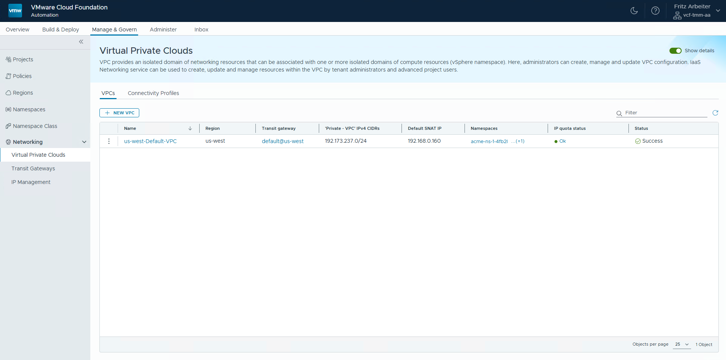
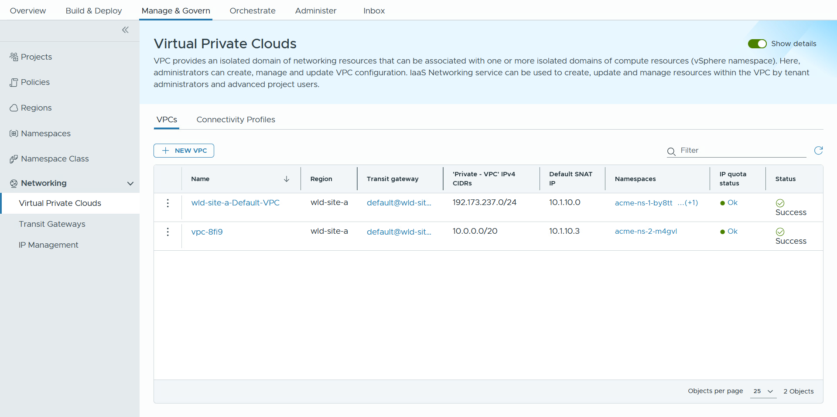
Support Network Governance and Enable Self-service Networking
Manage IP Addresses and Isolation via VPCs.
Enhance Security through network isolation.
Leverage VPCs networks for each application team to ensure isolation.
Link each VPC to one or more vSphere Namespaces for resource control.
Oversee IP addresses provided by IT Admins or external Providers to prevent conflicts.
Develop and manage IP addresses for internal use.
Notes:
Key Message:
Complete network governance for Org Admin with the power to enable self-service networking for consumers.
Talk Track:
By creating network isolation domains (VPC) for different application teams, organizations can significantly improve their security posture. Each team’s resources are separated, which minimizes the risk of data breaches and unauthorized access.
Managing IP addresses locally and coordinating them effectively with IT Admins or Providers allows for better resource allocation and reduces conflicts. This ensures that applications run smoothly without network disruptions.
Set up dedicated network isolation domains (VPCs) tailored for different application teams within the organization. This ensures that each team operates within its secure environment, minimizing the risk of cross-team interference and enhancing network security.
Allocate the created virtual private clouds (VPCs) to one or more vSphere Namespaces. This integration allows for better resource management, ensuring that each namespace can leverage the benefits of its assigned VPC for enhanced isolation and control over network resources.
Oversee the distribution and management of IP addresses provided by IT Administrators. This includes tracking allocated addresses, ensuring proper subnetting, and maintaining an organized IP address inventory to prevent conflicts and streamline network operations.
Develop and oversee a range of IP addresses that are specifically designated for use within the organization. This involves planning IP address allocations, managing the lifecycle of these addresses, and ensuring compliance with organizational policies and standards for internal network management.
Notes: Customer Benefits:
By creating network isolation domains (VPC) for different application teams, organizations can significantly improve their security posture. Each team’s resources are separated, which minimizes the risk of data breaches and unauthorized access. Customers care about this because protecting sensitive information and maintaining compliance with regulations are critical for their business integrity and trustworthiness.
Managing IP addresses locally and coordinating them effectively with IT Admins or Providers allows for better resource allocation and reduces conflicts. This ensures that applications run smoothly without network disruptions. Customers value this benefit as it leads to improved operational efficiency and reduced downtime, ultimately enhancing their productivity and cost-effectiveness in managing their IT infrastructure.
Key Attributes:
Set up dedicated network isolation domains (VPCs) tailored for different application teams within the organization. This ensures that each team operates within its secure environment, minimizing the risk of cross-team interference and enhancing network security.
Allocate the created virtual private clouds (VPCs) to one or more vSphere Namespaces. This integration allows for better resource management, ensuring that each namespace can leverage the benefits of its assigned VPC for enhanced isolation and control over network resources.
Oversee the distribution and management of IP addresses provided by IT Administrators or external Providers. This includes tracking allocated addresses, ensuring proper subnetting, and maintaining an organized IP address inventory to prevent conflicts and streamline network operations.
Develop and oversee a range of IP addresses that are specifically designated for use within the organization. This involves planning IP address allocations, managing the lifecycle of these addresses, and ensuring compliance with organizational policies and standards for internal network management.
Resources:

Slide 15
Migrations
HCX
Integrated Migration Planning
Non-disruptive Workload Migration
Simplified HCX Experience

Slide 16
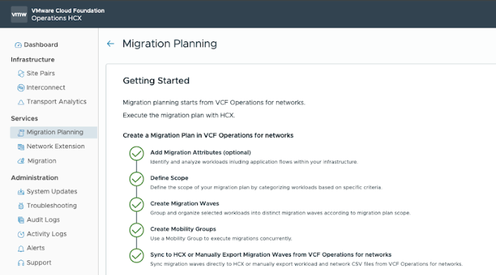
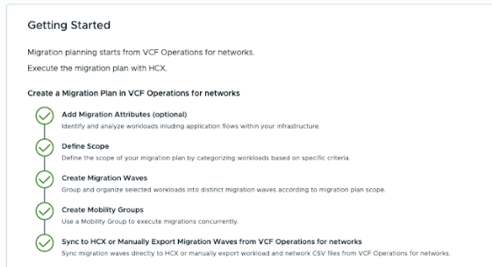
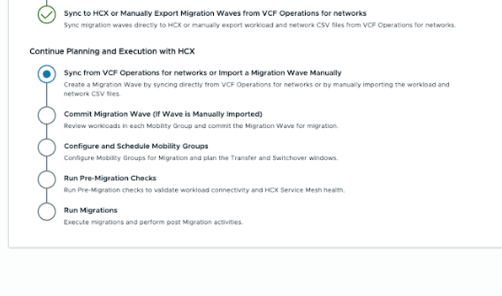
Seamless Migration Planning and Execution
Automation of Migration Planning between VCF Operations for Networks and HCX
V\
Automatically import Plans from VCF Operations for Networks directly into HCX
Process imported data to auto-create HCX Networks and Mobility Groups
Ability to modify Migration Wave from HCX
Ability to manually import Migration Wave
Notes:
Presenter Note: This slide contains animation
Key Message:
Seamless integration of Migration Planning with VCF Operations for Networks
Talk Track: We're thrilled to introduce a significant enhancement to your migration experience: seamless integration between VCF Operations for Networks and HCX. This means you can now dramatically simplify and accelerate your workload migrations.
<click 1> Let's break down the key benefits. First, with direct Migration Wave import, you can automatically pull your meticulously crafted network migration plans from VCF Operations for Networks directly into HCX. In other words, this means we've automated the creation of HCX Networks and HCX Mobility Groups, including their scheduling, from the migration waves you create in VCF Operations for Networks. And finally, we understand that flexibility is crucial. That's why you have the power to fine-tune and modify these migration groups directly within HCX, ensuring they perfectly align with your specific requirements. In essence, this integration streamlines the entire migration lifecycle. From initial planning in VCF Operations for Networks to execution in HCX, we've created a cohesive and automated workflow, empowering you to migrate with confidence and efficiency. Migration Planning is accomplished through a guided wizard, making the process intuitive and user-friendly. We're confident this feature will significantly simplify your migration journey.
Notes: Migration Planning integration was launched in VCF 5.2.1 but there was manual steps involved between AON and HCX. Now we are re-launching Migration Planning as those steps has been automated. Resources:

Slide 17
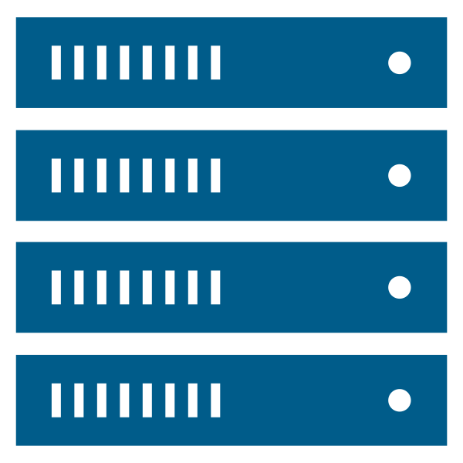
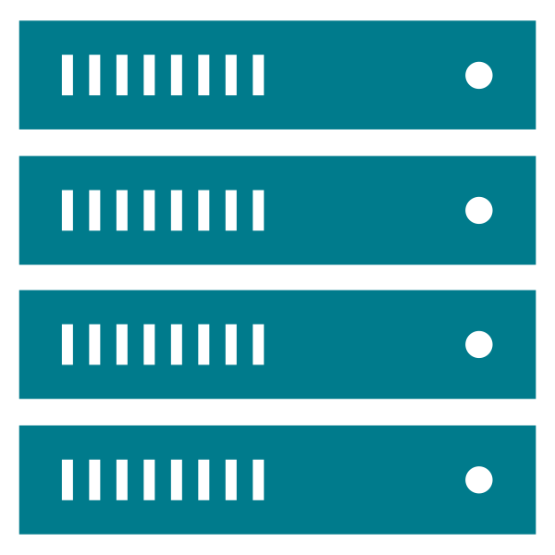
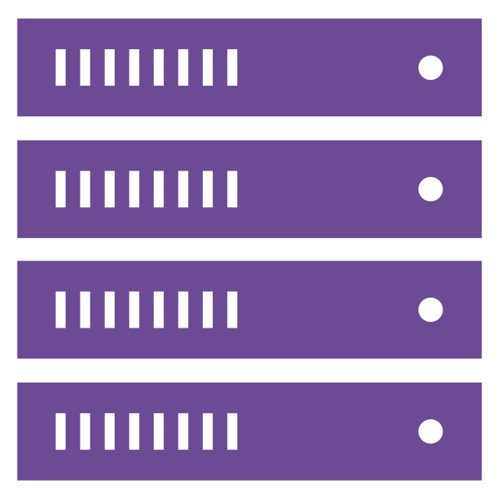
Non-Disruptive Workload Migration to VPC
HCX Migration and Network Extension support for NSX VPC
NSX VPC and Project support
Migration To and Between VPCs
L2 Network Extension To and Between VPCs
All Migration types and all Extension features supported except MON
Project and VPC as Primary Entities in HCX
Enables non-disruptive migration to VPC
V\
HCX Service Mesh
(IPsec tunnels)
VM4
Subnet A
Subnet B
Subnet C
Subnet D
VPC 1
VPC 2
VPC 3
VPC 4
VM2
VM3
VM1
HCX Network Extension (L2)
VLAN 1
VLAN 2
VCF Cluster 1
VCF Cluster 2
HCX Manager
vCenter
VCF-Site B
VCF-Site C
vCenter Site A
Notes:
Presenter Note: This slide contains animation
Key Message:
Seamlessly migrate your workloads to NSX VPCs with HCX, enabling large-scale, non-disruptive private cloud adoption.
Talk Track:
We're thrilled to announce a major advancement in HCX: full support for NSX Virtual Private Clouds, or VPCs. This means you can now leverage the powerful network segmentation and self-service networking capabilities of NSX VPCs for your existing workloads by seamlessly migrating them into VPCs via HCX. First and foremost, HCX now treats NSX Projects and VPCs as primary entities. This fundamental change allows you to migrate workloads to, from, and between VPCs without any downtime. This provides unparalleled flexibility for your private cloud adoption initiatives. And to ensure a truly non-disruptive experience, we've extended HCX Network Extension (L2) capabilities to VPCs. This means you can maintain consistent network connectivity between your current networks (VLAN or NSX Network) and VPCs, enabling wave migrations and ensuring a smooth, well-crafted planned migration.
Importantly, all of our existing migration types are supported with VPCs, with the exception of Mobility Assisted (MON). This comprehensive support allows you to leverage the migration type that best suits your needs.
Ultimately, this enhancement empowers you to modernize your infrastructure to VPCs with confidence, knowing that HCX provides a seamless and non-disruptive pathway to VPCs. This simplifies your journey to a more secure and agile private cloud environment.
Following are some of the use cases this feature will enable:
<click 1>:
Non-disruptive migration from VLAN backed Network to VPC
<click 2>:
Non-disruptive migration from VLAN backed Network to VPC w/ Network Extension so workload can continue to communicate with older site (example: common services, etc.)
<click 3>:
Also, enables Non-disruptive migration between VPCs
Notes: Resources:

Slide 18
Workload Migration to Supervisor Cluster
HCX Migration support for Supervisor Cluster
Support Supervisor Onboarding (Migration Only)
Support for multi-NIC VM
Bulk migration types only
HCX support all Supervisor supported Guest OS
Build with Robust and Resilient Architecture
V\
HCX Service Mesh (IPsec tunnels)
Subnet
Subnet
Subnet
VPC 1
VPC 2
VPC 3
VM2
VM1
WORKLOAD DOMAIN 1
WORKLOAD DOMAIN 2
VLAN 1
NSX Network
Supervisor Cluster
HCX Manager
vCenter
VCF-Site B
vCenter Site A
Notes:
Presenter Note: This slide contains animation
Key Message:
Migrate your workloads to Supervisor Cluster with HCX.
Talk Track:
We're expanding HCX's migration capabilities to include support for Supervisor Clusters. This allows you to leverage HCX's proven migration technology to bring your workloads directly into your Kubernetes-based Supervisor environment. It's important to note that this initial release focuses specifically on migration. HCX now supports the onboarding of your workloads into Supervisor Clusters. We are only supporting Bulk and Cold migration types for this feature. To ensure compatibility with modern applications, HCX now supports multi-NIC VMs during migrations to Supervisor Clusters. This allows you to migrate complex application topologies without modification. We are also supporting all Supervisor supported Guest OS. And to provide you with peace of mind, HCX's robust rollback and resiliency features are fully supported for Supervisor Cluster migrations. This ensures that you can confidently migrate your workloads, knowing that you have the ability to revert or recover if needed. In essence, HCX now offers a simplified and reliable pathway to migrate your workloads into Supervisor Clusters, enabling you to take advantage of the benefits of Kubernetes-based infrastructure.
Following are some of the use cases this feature will enable:
<click 1>:
Migration from NSX Network (overlay) backed Network to VPC in a Workload Domain
<click 2>:
And of course, migration from VLAN backed Network to VPC in a Workload Domain
Notes: Resources:

Slide 19
Non-Disruptive Workload Migration to a Federated Environment
HCX Migration support for NSX Global Objects/Segments
NSX Global Segment is supported in HCX Migration
Global Segment is supported in HCX Compute Network Profile as a guest network for the OSAM
Enforcement of NSX Federated Network
Enables non-disruptive migration to NSX Global and Local Segments
V\
HCX Service Mesh (IPsec tunnels)
NSX Global Segment
NSX Local Segment
NSX Local Segment
VLAN
VM4
VM3
VM1
VM2
NSX LM
NSX LM
NSX GM
VC
HCX Manager
VC
HCX Manager
VCF Cluster
VLAN 1
VLAN 2
VCF Cluster
HCX
Site Pairs
HCX Manager
vCenter
VCF-Fed Site B
VCF-Fed Site A
vCenter Site 1
Notes:
Presenter Note: This slide contains animation
Key Message:
HCX facilitates seamless workload migration to NSX Global and Local Segments within a Federated environment.
Talk Track:
We're enhancing HCX's migration capabilities to support the NSX Federated Environment. This means you can now seamlessly migrate your existing workloads, whether they reside on VLAN-backed networks or NSX networks, directly to NSX Local or Global Segments within a federated environment. A key aspect of this enhancement is HCX's intelligent detection of the NSX Federation. When HCX recognizes that the source/target NSX environment is part of a federation, it automatically ensures that no L2 Network Extensions are deployed. This is critical to prioritize and maintain the integrity of your NSX Federation stretched network. Furthermore, if HCX detects that an NSX environment with an existing Network Extensions has been incorporated into NSX federation, in other words NSX is now Local Manager (LM), HCX will proactively disable any and all Network Extensions associated with that now-federated LM NSX. This action prevents potential L2 loop and ensures that the federated network's stretched capabilities are not compromised. In essence, HCX now provides a reliable and compatible migration path to NSX Global and Local Segments within a federated environment, while safeguarding the integrity of your federated network architecture. This ensures a smooth and controlled migration experience.
<click 1>:
Non-disruptive migration from VLAN backed Network to VLAN, nothing new here we support this forever.
But, following are some of the new use cases this feature will enable, like:
<click 2>:
Non-disruptive migration to NSX Local Segment (in NSX LM), on one of the federated site.
<click3>:And of-course, Non-disruptive migration to NSX Global Segment, this segment is stretched between both federated sites.
<click 4>:
Also, Non-disruptive migration to NSX Local Segment, another federated site.
Notes: Resources:

Slide 20
Non-Disruptive Workload Migration from NSX VLAN Segments
HCX Migration and Network Extension support for NSX VLAN Segments
NSX-VLAN support
Migration From, To, and Between NSX-VLAN
L2 Network Extension From, To, and Between NSX-VLAN
All Migration types and all Extension features supported except MON
Automates NSX VLAN segment creation at the Dest.
More flexibility by supporting wider migration scenarios
V\
HCX Network Extension (L2)
HCX Service Mesh (IPsec tunnels)
VM1
VM2
VM3
VM4
VM5
NSX VLAN
NSX NETWORK
VLAN
NSX Network
NSX VLAN
VCF Cluster
HCX Manager
vCenter
VCF-Site B
vCenter Site A
Notes:
Presenter Note: This slide contains animation
Key Message:
Support for NSX VLAN Segments for Non-Disruptive Workload Migration
Talk Track:
We're pleased to announce enhanced support for NSX-VLAN Segments within HCX, significantly increasing your migration flexibility. This enhancement allows you to seamlessly migrate workloads from, to, and between NSX-VLAN Segments. So, if you are already an NSX shop utilizing NSX-VLAN, you can move your workloads from that network without changing network topology. This also provides customer flexibility to non-disruptively migrate workloads from NSX-VLAN backed networks to VPC, NSX Network (overlay), NSX-VLAN, or VLAN (dvpg). Furthermore, HCX now supports L2 Network Extension with NSX-VLAN Segments. This ensures consistent network connectivity during migrations, enabling wave migrations and provides flexibility with the transition process. Importantly, all HCX migration types are supported with NSX-VLAN Segments, with the exception of Mobility Optimized Networking (MON). This comprehensive support allows you to choose the migration method that best suits your specific requirements. A significant benefit of this feature is the automated creation of NSX-VLAN Segments at the destination, in case the NSX-VLAN segment doesn't already exist. This makes the migration process faster, reducing manual configuration and potential errors. Ultimately, this expanded support for NSX-VLAN Segments provides you with increased migration flexibility, allowing you to address a wider range of migration scenarios with confidence and ease.
<click 1>: Non-disruptive migration from VLAN backed Network to NSX Network, nothing new here we already support this.
<click 2>: Same, Non-disruptive migration from NSX Network to NSX Network, nothing new here either.
But, following are some of the new use cases this feature will enable, like:
<click 3>: Now you can do a Non-disruptive migration from NSX-VLAN to NSX Network (Overlay).
<click 4>: Or a Non-disruptive migration from NSX-VLAN to another NSX-VLAN Network. While also having a Network Extension between them for continues L2 connectivity.
Notes: Resources:

Slide 21

Simplified Deployment Experience with HCX Unified Manager
Single HCX Manager Appliance + Deprecated Features
HCX Manager Unification
HCX Unified Manager – Only one binary (OVA/OVF) for both Source and Destination sites
Unified Mgr assumes the role of Cloud or Connector based on the site-pair direction
Support upgrades from older version (4.11) HCX Cloud, HCX Connector to Unified Mgr
Unidirectional site pairing and Bidirectional site pairing will be supported as previous version with HCX Unified Manager
V\
Removal of WAN Optimization
Deprecation of appliance (WAN-Opt)
Removal of V2T Migrations
Removal of HCX Disaster Recovery
Removal of HCX Plugin from vCenter
Notes:
Key Message:
Introducing the HCX Unified Manager Appliance
Talk Track:
This slide highlights two key changes in the latest HCX release: the unification of the HCX Manager and the strategic removal of certain features. In Section One, we're introducing the HCX Unified Manager. This means we're moving to a single binary, or OVA/OVF, for both your source and destination sites. This simplifies deployment and management significantly. The Unified Manager will intelligently assume the role of either a Cloud or Connector appliance, based on the site-pair direction, so you don't have to worry about deploying separate appliances and their LCM. We've also ensured a smooth upgrade path. You can seamlessly upgrade from older versions, specifically 4.11 HCX Cloud and HCX Connector, to the Unified Manager. And rest assured, both unidirectional and bidirectional site pairing will continue to be supported, with the same architectures that are supported in previous versions. In Section Two, we want to highlight the removal of certain features from HCX. This includes the removal of WAN Optimization, the V2T Migration capability, HCX Disaster Recovery, and the HCX Plugin from vCenter.
Notes: Resources:

Slide 22


What’s New in VMware Cloud Foundation 9
Deliver a Unified
Cloud
Experience for Developers
Secure
and Protect your Private Cloud
Modernize
Infrastructure
VCF Deployment Pathways
SDDC Infrastructure
Fleet Management & Operations
Deliver Self-service IaaS
Migrating to VCF
Infrastructure for Kubernetes
Private AI
Security Operations
Extended VM-level Data Protection
Protecting VMs Across Clusters
Resiliency & Security
Notes:
Infrastructure for Kubernetes
Private AI

Slide 23
Infrastructure for Kubernetes
Supervisor, NSX Projects and VPC Integration
Asynchronous Supervisor Releases
Deploy Developer-ready Infrastructure at scale

Slide 24


Unlock Cloud Experience with vSphere Supervisor
Deliver a consistent Service consumption experience with an embedded Declarative API
Supervisor Services
Deploy and manage Virtual Machines, Kubernetes clusters, and other resources using a single API
vSphere Supervisor provides an extensible ecosystem with Supervisor Services
Add new functionality when needed while providing a consistent consumption experience
Certificate Management
Secret Store
Operators
Operators
TKG Service
vSphere Kubernetes Service (VKS)
VM Service
Network Service
Storage and Data Services
Backup Service
Image Registry
Supervisor Control Plane
Supervisor
Notes:
Key Message:
vSphere Supervisor is an integral part of the Cloud Experience story.
Talk Track:
vSphere Supervisor is an embedded Declarative API allowing customers to deploy and manage Virtual Machines, Kubernetes clusters, and other resources, all on the same platform and using a unified set of tools.
On enablement it provides a set of Core Supervisor Services, which include:
vSphere Kubernetes Service (VKS) – allowing customers to deploy and manage fully conformant Kubernetes clusters
VM Service – allowing customers to deploy Virtual Machines using desired state
Network Service – allowing customers to deploy load balancers on-demand
Storage and Data Services – allowing customers to deploy Persistent Volumes on-demand
Customers can deploy additional Supervisor Services to provided additional functionality for their workloads, like an Image Registry (Harbor) or a Secret Store
vSphere Supervisor is a Kubernetes-based ecosystem that’s highly extensible allowing us to introduce new Services while maintaining the same consumption experience.
Notes:
Resources:

Slide 25
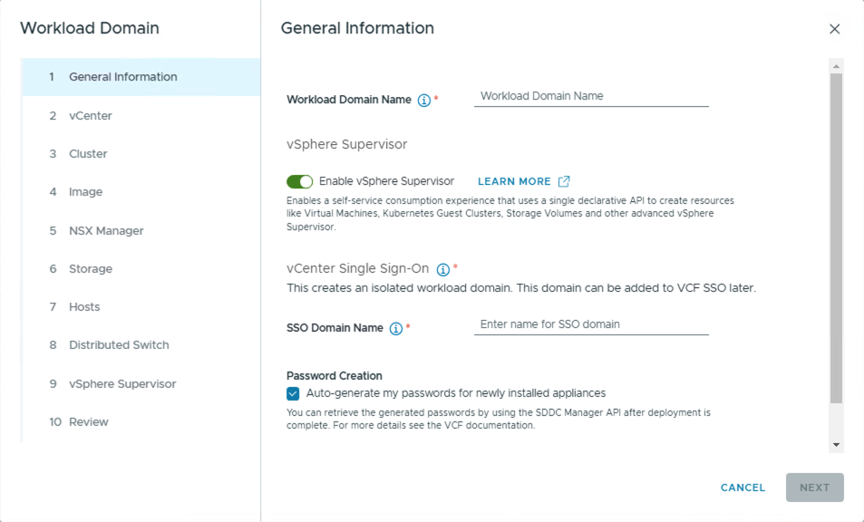

Enable vSphere Supervisor during Workload Domain creation
Providing consumption ready environments at scale
Notes:
Key Message: Cloud admins can quickly and easily enable vSphere Supervisor as part of the Workload Domain creation. Talk Track: VCF Operations contains an in-built workflows to create new Workload Domains pre-configured with the vSphere Supervisor. This option provides an opinionated way of deploying Supervisor and relies on minimal input from customers. This deployment model utilises NSX Projects and VPCs which can be selected from the drop-down menu.
Notes: Customers must complete NSX Edge deployment after the WLD creation.
Resources:

Slide 26
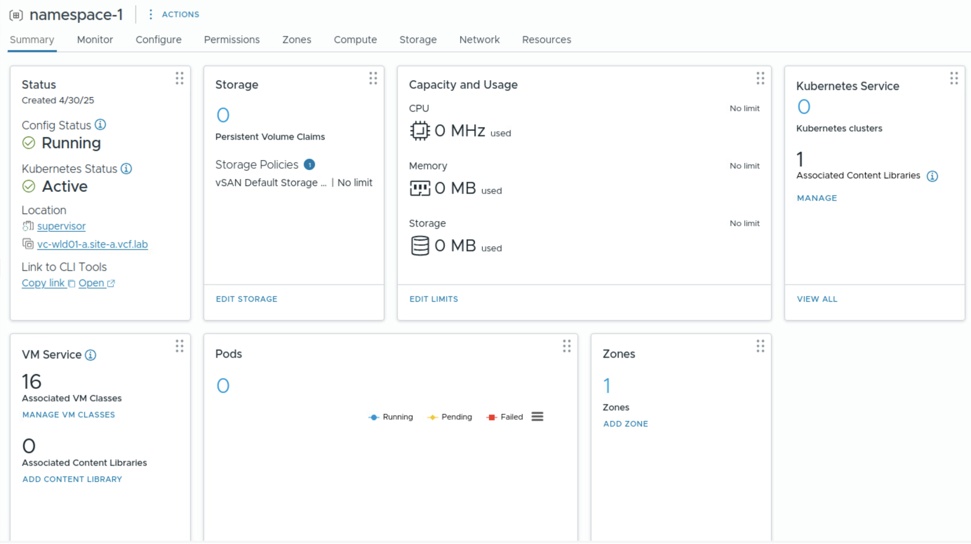
Provide workload isolation with VPC based vSphere Namespace
Creating Network Tenancy
Isolate workloads for apps, teams, or stages of development with vSphere Namespaces
Configure VM Classes and Content Libraries
VPC integration provides Network Tenancy at Namespace Level
NSX Project
namespace-1 VPC
Private Subnet
External Subnet
PrivateTGW Subnet
vSphere Namespace
Supervisor Control Plane
Supervisor
Notes:
Key Message: vSphere Namespaces are logical units providing resource and network isolation through VPC integration. Talk Track: vSphere Namespaces form a resource envelope for workloads. They are similar to resource pools, but with extended capabilities. They allow customers to set resource allocations, quotas, and limits, but also to define storage policies and zones. They also provide basic configuration options for VKS and VM Service, such as configuring Content Libraries and associating VM Classes.
vSphere Namespaces also provide workload isolation for organisations, whether they want to provide isolation for applications, or perhaps group them by teams. You may also want to split namespaces according to various states of development, such as test, staging, and production.
To provide greater network isolation, vSphere namespaces now integrate with VPCs. DevOps teams can configure network isolation via VPCs without needing to understand the details of the underlying network. They may create use existing VPCs, or created their own based on VPC Connectivity Profiles configured by Admins. DevOps teams can also assign their own Private IP ranges as part of VPC creation as these don’t impact other networks.
Notes: Admins will have assigned VPC Connectivity and Service Profiles to the DevOps users. Those profiles contain things like the NSX Edge, T0, External IP Blocks, Transit Gateway and Private TGW IP blocks so DevOps doesn’t need to be concerned with them.
DevOps may create their own VPC based on those profiles or use preconfigured VPCs assigned to them.
Resources:

Slide 27
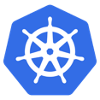
Creating Isolation between Control Plane and Workloads
Introducing Management and Workload Zones
Separate management Control plane VMs from workload VMs and Kubernetes clusters
Easily add capacity to vSphere Supervisor with vSphere Zones
vSphere namespaces can span one or more vSphere Zone
Add additional Zones to vSphere Namespace
Kubernetes Applications
Control Plane
VM
Node
Node
Node
Kubernetes Cluster
vSphere Namespace
Kubernetes Applications
Kubernetes Applications
Kubernetes Applications
Kubernetes Applications
VM
VM
Control Plane
Control Plane
Control Plane
Control Plane
Node
Node
Node
Node
Node
Node
Node
Node
Node
Node
Node
Node
Kubernetes Cluster
Kubernetes Cluster
Kubernetes Cluster
Kubernetes Cluster
vSphere Namespace
+ zone
Supervisor Control Plane
Supervisor
management zone
workload zone
Notes:
Key Message:
Customers can now create dedicated workload zones separated from management.
Talk Track:
Customers can now easily increase Supervisor Additional vSphere Zones can easily be added to Supervisor capacity. You do not need to deploy Supervisor control plane VMs on each cluster - although that option is still available to you. Additional vSphere clusters are added as a vSphere Zone to the Supervisor.
This also allows for the Supervisor control plane VMs to be segregated from workload VMs and vSphere Kubernetes clusters on separate vSphere clusters / vSphere Zones.
vSphere namespaces can be created to span one or more vSphere clusters / vSphere Zones.
Notes:
The first zone created during Supervisor enablement will be marked as Management.
Resources:

Slide 28

Empower Platform Operators
Introducing Supervisor Administrator Role in vCenter
Allows VI Admins to delegate Supervisor management tasks to Platform Operators
Empower Platform Operators to manage and update Supervisor and Supervisor Services
vCenter Permissions are unified to Supervisor through Kubernetes RBAC
Bridging the gap between vCenter and Supervisor permissions
vCenter
VC Role
vmware-system:Namespaces.Manage
Supervisor
Administrator
Kubernetes Role
vmware-system:Namespaces.Manage
vSphere Namespace
Supervisor
Notes:
Key Message:
VI Admins can delegate permissions to Platform Operators to allow them to perform Supervisor management tasks
Talk Track:
Because administration of a Supervisor and its services involves a combination of vCenter and Supervisor cluster privileges, it was challenging to delegate Supervisor specific responsibilities to on VI Admin users. Now the Supervisor honors VC permissions, enabling the VI Admin to assign the Supervisor Administrator Role to users. This means that corresponding Kubernetes Roles are created to map to the VC permissions. Supervisor Administrators can do things like configuring Namespaces - setting limits, adding reservations, handling access control, or managing storage policies- without full administrative access. The administrator Role extends beyond an individual Supervisor and allows configuration of the Supervisor and its supporting services.
Notes:
Resources:

Slide 29






Update vSphere Supervisor independently
Delivering Asynchronous Supervisor Releases
Update Supervisor control plane independently of vCenter
Subscribe to Broadcom depot or manage an offline Content Library to deliver updates
Faster delivery of Supervisor releases and new functionality
PLATFORM ADMIN
BROADCOM CDN
Supervisor Control Plane
Supervisor
Compute
Storage
Networking
Notes:
Key Message:
In vSphere 9, Supervisor releases are decoupled from vCenter. Supervisor clusters can be patched/updated independently of vCenter. This allows more rapid delivery of new Supervisor versions and functionality.
Talk Track:
In vSphere 8, Supervisor releases are delivered via vCenter patches and/or updates. In vSphere 9, Supervisor releases are decoupled from vCenter. Supervisor clusters can be patched/updated independently of vCenter. This allows more rapid delivery of new Supervisor releases and functionality.
Notes:
Resources:

Slide 30
Private AI
Private AI Services

Slide 31
Simplify the Deployment of Private AI
VMware Private AI Foundation with NVIDIA
Overview
Configure Cloud Foundation for Private AI workloads using NVIDIA GPU technology and the NVIDIA AI Enterprise Suite
Utilize private cloud infrastructure to run customized AI workloads
Consumers can utilize different AI application types
Infrastructure is deployed, scaled, lifecycle managed by VCF admin
VMware Private AI Foundation is enabled for installation within the vSphere client with an Add-on license
Notes:
Presenter Note: This slide contains an animated GIF
Key Message:
VMware Cloud Foundation includes orchestrated guidance to set up VMware Cloud Foundation infrastructure to run Private AI workloads using NVIDIA GPU technology and components of the NVIDIA AI Enterprise Suite.
Talk Track:
VMware Cloud Foundation 5.x introduced a number of new orchestrated workflows to simplify the configuration of a Private AI platform inclusive of the infrastructure stack, Kubernetes runtime, and AI/ML cloud templates.
This joint solution with NVIDIA is known as VMware Private AI Foundation with NVIDIA and is available as an Advanced service to run together with NVIDIA GPU devices and the NVIDIA Private AI Enterprise Suite.
VCF 9 takes this further allowing admins to configure Private AI from within the vSphere client which can be configured using a new set of powerful Private AI Services.
The process to “Deploy VMware Private AI in vSphere” is initiated from within the vSphere client.
A VMware Private AI Foundation Add-on license is required.
Private AI infrastructure can be deployed in cloud-connected or cloud-disconnected mode.
Orchestrated workflows guide the VCF admin though the deployment steps to configure private AI infrastructure.
Once infrastructure is deployed consumers (Data Scientists and AI Developers) can utilize this platform to support different AI application types, such as a deep learning virtual machines and Kubernetes clusters, applications based on NVIDIA NGC container images, and vector databases for Retrieval Augmented Generation (RAG). Private AI workloads can then be deployed by consumers using the self-service catalog from VCF Automation.
Another key benefit of this on-prem Private AI solution is that the underlying hardware and SDDC-based Infrastructure is all deployed, scaled and lifecycle managed by the VCF Administrator.
Notes:
- VMware introduced orchestrated workflows to simplify the configuration of a Private AI platform inclusive of the infrastructure stack, Kubernetes runtime, and AI/ML cloud templates in VCF 5.x. - VMware Private AI Foundation with NVIDIA is deployed on top of VMware Cloud Foundation infrastructure and is available as a licensed add-on.
From VCF 9, VMware Aria Automation and VMware Aria Operations have been rebranded to VCF Automation and VCF Operations.
Contour is optional. Alternatively a user can create a load balancer when installing Harbor instead of relying on Contour for ingress
Resources:
For further information on deploying VMware Private AI Foundation with NVIDIA please refer to the VMware Private AI Foundation with NVIDIA Guide:
https://docs.vmware.com/en/VMware-Cloud-Foundation/index.html

Slide 32





Private AI Services (PAIS)
Model Store | Model Endpoints | Data Indexing & Retrieval | Agent Builder
vSphere Supervisor Namespace
Harbor as Model Store
Storage for all validated and secure models shared with appropriate teams.
Model Runtime
Service consumes available model in Harbor to support Model Endpoint creation
Agent Builder Service
Used to build, iterate and serve AI agents (builds RAG pipelines)
Pull model from online source: Hugging Face, NVIDIA NGC…
Deep Learning VM (DMZ)
Validate your model
Agent API Endpoint
Customer Application
Data Indexing and Retrieval Service
Connects to different data sources. Loads relevant data into vector databases
Data Sources
Vector DB (DSM)
VI Admin
MLOps
Developer
Data Scientist
Notes:
Key Message: Private AI Services is a new set of functionality for deploying AI applications that comes as part of the VMware Private AI Foundation SKU at VCF 9.0. This is a summary of the activities of the data science team along with people who support them (devops or ML operations, system admin) and the application developers who use the model in their app. The flow from left to right shows how these different user types use the PAIS services.
Talk Track:
The Private AI Services (PAIS) are a new addition to VMware Private AI Foundation with NVIDIA, an advanced service to VCF 9. The new services streamline the deployment and management of AI/Gen AI workloads for enterprise customers, particularly implementing the very popular RAG (retrieval augmented generation) design pattern for AI-based applications in the first release.
Private AI Services is deployed by the System Admin/devops/ML Operations person as a VCF Supervisor service. During its setup time, PAIS is added to the Supervisor and a PAIS YAML file is used to configure it for your namespace. VI Admins can view and manage Private AI Services in VCF Automation.
The diagram shows the flow of an LLM model usage from
initial model download from external sites, (new models appear publicly on a regular basis and data scientists want to try them out)
pushing it to the Model Store from the deep learning VM, once it is tested and validated for safety in a deep learning VM,
using the Model Runtime service to give users a Model Endpoint for accessing it (i.e. a reference point for using the model),
using the Data Indexing Service for handling your enterprise’s private data in a vector database
using the Agent Builder to construct an application from the model endpoint and the indexed knowledge base that front-ends a vector database.
Extended Talk Track:
Shown in the diagram is an example of how a model is tested and consumed during its lifetime – along with the private data that is stored in a vector database.
On the top left side, models are pulled from online sources such as Hugging Face, NVIDIA NGC or others. Those sites contain large numbers of models that have been uploaded by organizations who allow them to be used for business purposes with open licensing. It is very natural for an enterprise’s data science teams to want to use the latest models from those sites. An example of this is the Llama family of models, contributed by Meta/Facebook or the Mistral models from an organization with that same name.
Data Scientists download, test, validate and check these open-use models for use with VMware Private AI Foundation with NVIDIA in a deep learning VM running in a DMZ environment. This deep learning VM is deployed by a user by using the Catalog item called “AI Workstation” in VMware Private AI Foundation with NVIDIA (the existing product that shipped in VCF 5.2.1).
Once the data science team has fully tested and approved the new model, and they are happy with its accuracy, performance and safety, then the Harbor Registry is used as a Model Store for storing internally validated and secure models. By storing (pushing) the model into the Model Store, data scientists are asserting that the model is safe and can be used by MLOps teams and application developers who use the model as part of their app design. The model store is therefore a central repository of models in the activity of “Model Governance”.
Next, the Model Runtime service is used to create a Model Endpoint (i.e. a reference point) that will be used for inference work using that model.
You can think of a Model Endpoint as a connection point for calling the model to do some work (such as creating new text). The Model Endpoint will be used later on in the process by the Agent Builder.
As part of the creation of a Model Endpoint using the Model Runtime service, an entry for that particular model from the Model Store is used to identify it. Then the Model Runtime service performs a set of actions on an underlying VKS cluster (that is hidden from the user) to deploy the model (i.e. start it up) using an inference server such as vLLM or Infinity. These inference servers are open source server processes that bring the model to life in a pod that runs within a VKS node.
Additionally, an API Gateway (a front-end part in the Model Runtime) can be configured which provides a stable and secure API interface for accessing model endpoints.
MLOps teams/App Developers can now consume the available models running in a namespace under the control of the model runtime service. Applications/agents use the model endpoints along with data from a Vector database that has been pre-loaded, as a separate step.
The Data Indexing and Retrieval Service is used to take your private data sources, collect them into a Knowledge Base (key concept) and convert that data into a new form called “embeddings”. That new embeddings form of the private data is then loaded into a vector database under the control of the Knowledge Base. Data sources can be local files, Confluence pages, Sharepoint directories, Google drives or S3-compatible sources. An example of a data source can be one or more PDF documents that give an internal description of a new product that is not yet released to the public.
The Agent Builder Service is then used to by Developers to build RAG pipelines for applications. The Agent Builder service is used build, test, and serve AI agents such as a RAG Agent, that brings together one or more model endpoints and a knowledge base/vector database. This pipeline of components/services is used by an end-user application through calling the new Agent.
The newly-created Agent presents an API endpoint to a front-end customer application, such as an interactive chatbot application for our customer representatives to use within the enterprise.
User Interfaces to PAIS
A user would create their initial model endpoints within the Model Runtime service that is seen within the VCF Automation PAIS screen.
The “Data Indexing & Retrieval” service and “Aqent Builder” service have separate UIs of their own, that are accessed from the Private AI Services main screen in the VCF Automation tool.
Notes: Private AI Services are available with the VCF when using the VMware Private AI Foundation Advanced (Add-on) License to VCF 9.

Slide 33
What’s New in VMware Cloud Foundation 9
Deliver a Unified
Cloud
Experience for Developers
Secure
and Protect your Private Cloud
Modernize
Infrastructure
VCF Deployment Pathways
SDDC Infrastructure
Fleet Management & Operations
Deliver Self-service IaaS
Migrating to VCF
Infrastructure for Kubernetes
Private AI
Security Operations
Extended VM-level Data Protection
Protecting VMs Across Clusters
Resiliency & Security
Notes:
Integrated Security Operations
Extended VM-level Data Protection
Protecting VMs Across Clusters
Resiliency at every layer
Security at every layer

Slide 34
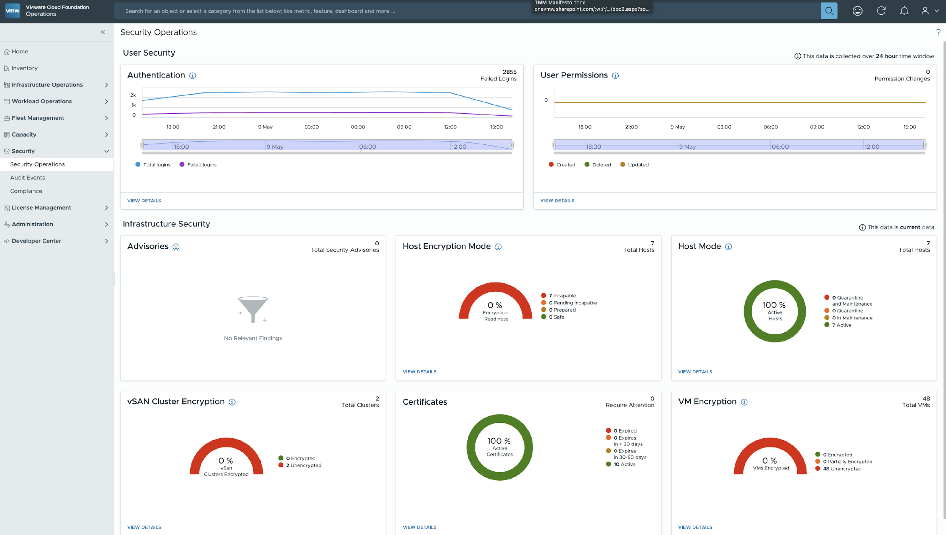
One-Stop Dashboard for Baseline Security Operations
User and Infrastructure Security
An overview page providing a holistic view of the organization’s security stance across VCF deployments.
Benefits:
- Enhanced visibility
- Improved security and resilience
- Proactive defense
Notes:
Key Message:
The Security Operations Dashboard provides a comprehensive, real-time view of user authentication, permissions, and infrastructure security, helping organizations proactively manage security across VCF deployments.
Talk Track:
“This slide highlights the Security Operations Dashboard, a centralized view for monitoring both user and infrastructure security across your VCF environment.
At the top, the dashboard provides user-focused metrics like authentication attempts, failed logins, and permission changes over time.
Below, it delivers insights into infrastructure security, covering key areas like host encryption, host mode compliance, vSAN cluster encryption, advisories for CVE violations, certificate health, and VM encryption status.
All of this information is gathered in real time, giving security teams immediate visibility into potential vulnerabilities and helping them take proactive action.
By consolidating security monitoring into one dashboard, VCF enables better security resilience and a faster response to threats.”
Notes:
1. Introduction to Security Challenges
• As organizations scale, security threats become more complex and more challenging to monitor.
• Traditional security tools often lack integration, real-time visibility, and automation in responding to threats across workloads and infrastructure.
• The VMware Cloud Foundation Operations Security Operations Dashboard offers a centralized, proactive approach to managing user and infrastructure security.
2. Key Features of the Security Dashboard
• Enhanced Visibility: The dashboard provides a clear and real-time view of authentication activity, user permissions, and security advisories.
• User Security: Tracks authentication failures, permission changes, and access modifications to detect suspicious behavior.
• Infrastructure Security:
• Advisories & Vulnerabilities: Monitors CVE vulnerabilities across the infrastructure.
• Host Encryption & VM Encryption: Ensures workloads are protected against unauthorized access.
• Cluster Encryption & Certificates: Keeps data encryption in check and manages security certificates.
• Holistic View Across VCF Deployments: Security teams gain a unified overview of security risks across their entire VCF infrastructure.
3. What This Dashboard Solves
• Lack of Centralized Security Management: Provides a single pane of glass for security insights.
• Slow Threat Detection & Response: Proactively monitors authentication, permissions, and encryption status to reduce attack surfaces.
• Visibility Gaps in Infrastructure Security: This tool identifies vulnerabilities and provides a clear security posture across hosts, clusters, and workloads.
• Compliance & Risk Management: Helps organizations stay compliant by tracking encryption, security advisories, and access controls.
Benefits:
• Proactive Defense: Reduces risk by detecting and addressing vulnerabilities before exploitation.
• Improved Security & Resilience: Strengthens the organization’s security stance with continuous monitoring.
• Faster Incident Response: Identifies threats in real time, ensuring a quicker response to potential security breaches.
• Better Compliance Management: Helps organizations meet security and compliance requirements effortlessly.
• Simplified Security Operations: Eliminates the need for multiple security tools by consolidating insights into one dashboard.
Resources:

Slide 35

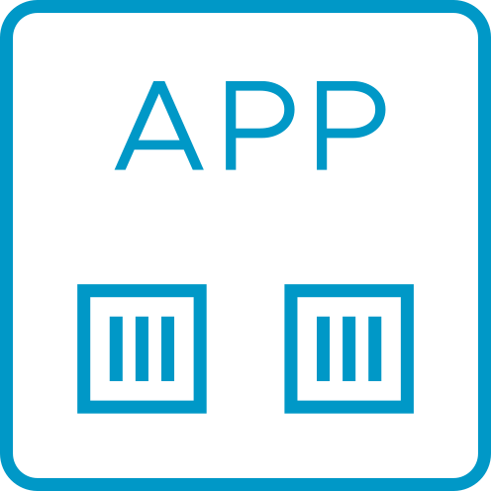

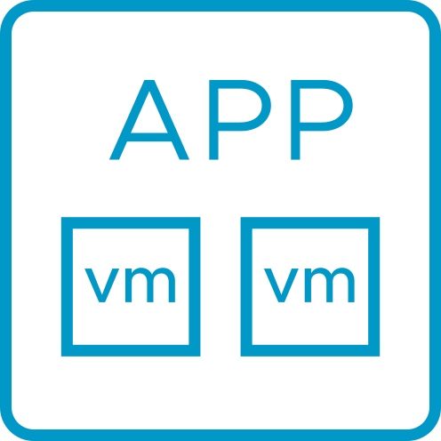
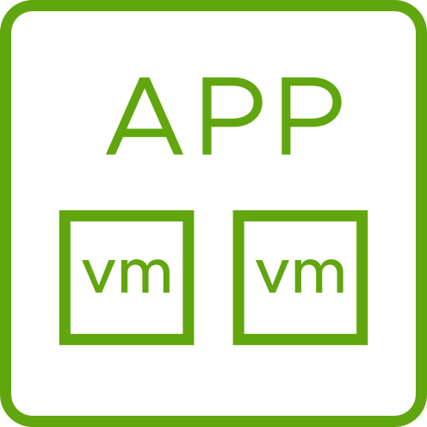
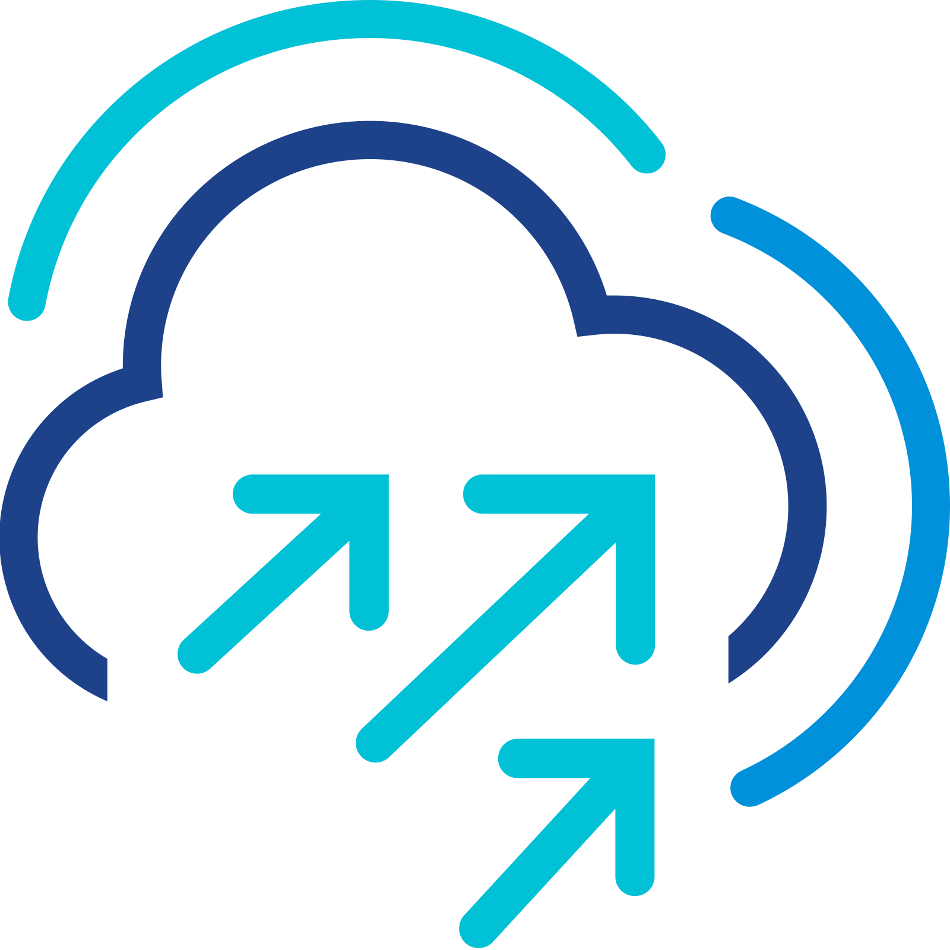
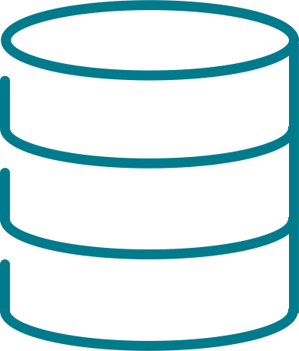
Extend VM-Level Data Protection to Remote vSAN Clusters
vSAN-to-vSAN replication as a part of VMware Live Recovery* (VLR)
Protect VMs locally and remotely using vSAN ESA snapshots
Replicate and recover courtesy of the VMware Live Recovery (VLR)
Use policy-based protection groups to define local and remote protection outcomes
Create relationships between multiple sites using site pairs
Ideal for disaster recovery, isolated recovery or long-term archiving
Supports vSAN HCI and vSAN storage clusters
VMware Live Recovery
VLR addon
VMware Live Recovery
vSAN Data Protection
Replicate as frequent as 1 minute
VMware Live Site Recovery (VLSR)
Local ESA snapshots
R
Replica
Failback & reprotect
Disaster Recovery/Failover
Cloud Foundation
vCenter Server
Cloud Foundation
vSphere
vSAN ESA
vSAN Data Protection
vSphere
vSAN ESA
CREATE PROTECTION GROUP
vSAN ESA
1. Choose local/remote
vSAN ESA
2. Select VMs
3. Create schedules
On-premises VCF cluster
On/off-premises VCF cluster
* Replication a part of the VLR addon license
Notes:
Presenter Note: This slide contains animation
Key Message/Talk track:
The introduction of vSAN Data Protection in VCF 5.2 delivered local data protection using vSAN ESA’s powerful and efficient snapshotting. vSAN Data Protection in VCF 9.0 extends this ability even further with the support of replication of those snapshots to another vSAN cluster. When using the VMware Live Recovery (VLR) addon, customers can easily create snapshots on a target cluster on premises, or off premises. VLR, or more specifically, VMware Live Site Recovery (VLSR) can be used to take these snapshots and recover or failover to the other location. Best of all, just like local snapshots, the policies defining frequency and retention of replicated snapshots can be achieved lightweight protection groups, so it behaves exactly as you would see it using local snapshots. Replicated snapshots can be ideal for DR, isolated recovery or long-term archiving objectives.
----------------------------------
Overview:
Protect VMs locally and remotely using vSAN ESA snapshots
Replicate and recover courtesy of the VMware Live Recovery (VLR)
Use policy-based protection groups to define local and remote protection outcomes
Create relationships between multiple sites using site pairs
Ideal for disaster recovery, isolated recovery or long-term archiving
Supports vSAN HCI and vSAN storage clusters
----------------------------------
Details:
vSAN 8 U3 introduced vSAN Data Protection. This provided a flexible and efficient way to use vSAN ESA’s high performance snapshot engine to augment customer’s existing protection strategies. While it introduced new ways that customers could recover and clone existing VM workloads, it didn’t support the ability to replicate the data to another vSAN cluster.
vSAN in VCF 9.0 extends vSAN Data Protection. This will allow customers to protect workloads locally AND remotely in a fast, efficient, and easy manner. This replication ability will be enabled by using the VMware Live Recovery addon.
Since this is a feature that is only capable with an addon license of VLR, the material in this slide will be a general overview of the capability. For a more comprehensive understanding on the capabilities, requirements and limits of vSAN-to-vSAN replication, see the official collateral created for VLR.
Protection groups remain as the method for assigning protection outcomes. This includes VM grouping, protection schedules, retention schedules, etc. It will be extended by allowing for the configuration of remote protection policies in addition to the local protection policies introduced in vSAN 8 U3.
It is the protection group that defines direction. This allows customers to define replication that occurs in one direction, or both directions.
Within a protection group, a user can choose to perform both a local snapshot and a remote replica, or just a remote replica. A local snapshot does not need to be created for a remote replica to occur.
For vSAN-to-vSAN replication, we are performing the replication step through the lightweight delta (LWD) mechanism as a part of vSphere Replication. This is what provides the coordination and the transport of the replica. Once the replica lands at the target site, an ESA snapshot is performed at the target, and our control plane will show a replica now living at the target location. This means that we perform replication using an approach of a “replicate and snapshot” versus “snapshot and replicate” as more commonly found with traditional storage solutions. We do this for several reasons, including, but not limited to:
Utilize vSphere Replications highly sophisticated transport engine for supreme efficiency. The LWD mechanism in vSphere replication is serves as an ideal control plane and transport method. This newer version is what gives us as low as 1-minute RPOs, and uses scalable host-to-host replication as opposed to old methods that funneled replica traffic through a virtual appliance.
The ability to have full copies of VMs at both sites. Replication is often serving a greater purpose, such as a site failover or failback, or perhaps an isolated recovery environment. Having complete copies of VMs at both sites, and not just the delta changes is what provides maximum flexibility for customer use cases. This is especially important when considering how solutions like VLR (in particular (VLSR) assume complete copies of data for its recovery plans.
Minimal dependency chain. If one were to only replicate snapshots changes, this would place full dependency on the need for the source VM at the original location, which would limit the failure scenarios that this would be able to protect against. Having fully VM autonomy provides the highest flexibility for recovery and reprotection of VMs.
Having complete copies at both sites will allow for deep snapshots at both sites. A key ability of vSAN data protection is the ability to create a deep chain of snapshots (currently up to 200 snapshots per VM). When we create copies at both sites, this extends our flexibility in snapshot retention beyond the native limitations of vSphere Replication which is typically limited to 24 snapshots.
Full protection and recovery API and UI. By replicating the VM to a target site then using ESA snapshots with vSAN Data Protection, this provides a full recovery and management API and UI, where as vSphere Replication on its own does not have a recovery API and a UI that was not integrated with vCenter Server.
Fast local snapshots. This offers better point-in-time recovery for VMs because vSAN snapshots do not require a stun of the VM.
In this release, the control-plane virtual appliances that were used by the discrete features and products such as vSAN Data Protection, Site Recovery Manager (now called VMware Live Site Recovery or VLSR) and vSphere Replication have all been consolidated into a single virtual appliance. This dedicated protection combined appliance (DPCA or DPA in the UI) will provide a much simpler experience for deployment and ongoing management.
Customers currently using vSAN Data Protection in vSAN 8 U3 will be provided with a guided workflow to migrate the content of the old data protection appliance into the new DPCA in VCF 9.0
The Host-Based Replication (HBR) Management System (HMS) is the mechanism responsible for maintaining relationships between clusters (e.g. site pairing) and the synchronization of protection groups and their metadata. It will typically play a part in report of helping to report VM snapshot instances, etc.
Establishing a relationship between two sites is known in the UI as a “site pair.” The pair is what allows for the protection groups to define not only local protection policies, but remote protection policies.
A source vSAN cluster can be configured to more than one target vSAN cluster (1:many), but the VMs in a protection group can only replicate to a single target vSAN cluster.
A target cluster may be a part of the inventory by the same vCenter Server, or a different vCenter Server. If the latter, it will need credentials to connect to the remote vCenter Server to perform the subsequent compatibility checks, etc.
Protection groups remain as the method for assigning protection outcomes. This includes VM grouping, protection schedules, retention schedules, etc. It will be extended by allowing for the configuration of remote protection policies in addition to the local protection policies introduced in vSAN 8 U3.
The basic protection workflow will be as follows:
Create site pair between clusters to establish relationship
Configure replication by creating a protection group that defines local protection, replication, or both. Define the other associated attributes, including:
Immutability mode
VM membership (individual selection, dynamic VM name patterns, or a combination of both)
Set appropriate creation and retention schedules
vSAN-to-vSAN replication can also incorporate stretched clusters on either side of a site pair. For example, one could be using a vSAN stretched cluster for a site-resilient, active-active datacenter providing zero RPO. This can be paired to a remote vSAN cluster for asynchronous replication with an RPO as low as 1-minute using VLR. The VLR addon (consisting of VLSR and VLCR) will provide all of the transport and orchestration.
The transport of data from the source cluster to the destination cluster is through vSphere Replication. Although, we are choosing not to highlight this for several reasons. The use of vSphere Replication for the transport allows vSAN Data Protection to take advantage of the use of the light-weight delta (LWD) orchestration framework already used in vSAN Data Protection for local snapshots.
This slide refers to VMware Live Site Recovery (VLSR) previously known as SRM. This is one part of the VLR addon for VCF. The other part is known as VMware Live Cyber Recovery, or VLCR. This is a cloud-based ransomware recovery solution. At this time, VLCR cannot provide a non-cloud/on-premises target.
vSAN Data Protection in VCF 9.0 will support the use of vSAN storage clusters for both local and remote protection.
Limitations
Replicating data remotely is contingent on the use of the add-on licensing for VMware Live Recovery (VLR). vSAN Data Protection is a part of their VCF and VVF licensing, but it is limited to local protection only.
For a comprehensive list of supported capabilities, see the appropriate documentation. But generally, vSAN Data Protection at this time is largely limited to protecting VMs. Other features such as the items listed below are not currently supported:
Protecting shares from vSAN File Services
Protecting volumes using iSCSI target services
VMs that are instantiated from a linked clone
VMs using vSphere FT
VMs using multi-writer
System VMs including vCenter Server, NSX Manager, and the unified DCPA.
Positioning
We may limit the amount of technical information on the method of transport between sites and some of the technical elements that make that occur. While we are using a next generation version of vSphere Replication, many customers may inadvertently conflate previous limitations with vSphere Replication with the capabilities in vSAN data protection. For this reason, the focus will be on the capabilities and the outcome, not specific nuances of the replication technology.
Note that we are NOT using the terminology of “native” when discussing replication. “Integrated” will be the preferred term.
Feature value in one sentence. vSAN-to-vSAN replication extends the impressive abilities by now allowing you to protect your workloads to a remote vSAN cluster.
Common Use Cases.
Disaster recovery courtesy of VMware Live Recovery (VLR)
Ideal for isolated recovery environments, as well as long term archiving
----------------------------------
Additional Information:
Superior Snapshots using VMware vSAN Data Protection: https://blogs.vmware.com/cloud-foundation/2024/08/02/superior-snapshots-using-vmware-vsan-data-protection/
Notes: This is an introductory slide intended to showcase vSAN-to-vSAN replication courtesy of the VLR addon. For a comprehensive understanding of this feature, see the appropriate presentation deck that details the capabilities of VLR.
Resources:

Slide 36
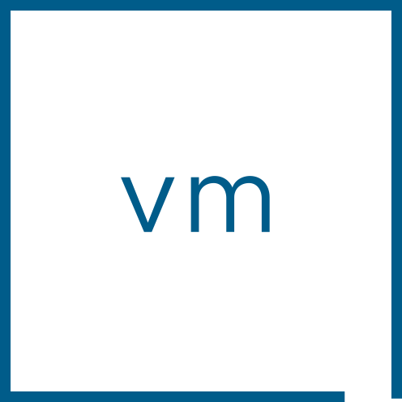

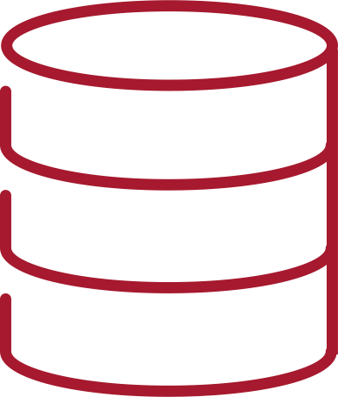
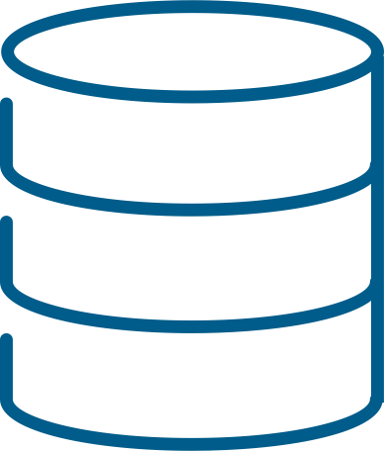

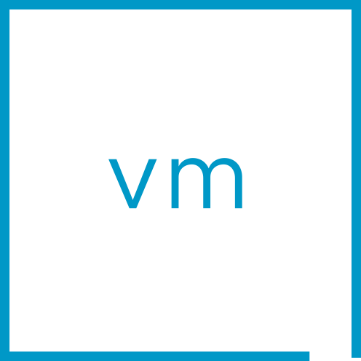

Unique Approach for Protecting VMs and Data across Clusters
Approach to remote protection* increase flexibility and capabilities for VCF
Array-based Replication
vSAN-to-vSAN Replication*
Snapshot LUN at source followed by replicating LUN to target
Replicate VM to target followed by snapshotting VM at target
Storage array
Replicate
Storage array
Replicate
vSAN
vSAN
Traits
Traits
Protection and recovery limited to LUN
May require similar arrays at source and target
May create a dependency of LUNs across sites
Additional array tooling needed to protect and restore
RPO dependent on characteristics of arrays
Snapshot retention dependent on characteristics of array
Granular per-VM protection and recovery
Source and target can be dissimilar vSAN clusters
Full autonomous copies of VMs at each site
Fully integrated protection and recovery APIs and UI
1-minute RPO – with no need to snapshot source
Up to 200 snapshots per VM at each site
* Replication a part of the VLR addon license
Notes:
Presenter Note: This slide contains animation
Key Message/Talk track:
Since vSAN and its highly scalable snapshot engine are integrated directly into the hypervisor, we were able to take a different approach to remote replication. Rather than perform a traditional snapshot then replicate workflow commonly found with storage arrays, we are able deliver replication in a unique way without needing to snapshot the VM data first. Pair this with our ability to protect data at a discrete VM-level, and this affords extraordinary levels of flexibility, protection options, and protection performance in the form of low RPOs.
----------------------------------
Overview:
Array-based replication
Protection and recovery limited to LUN
May require similar arrays at source and target
May create a dependency of LUNs across sites
Additional array tooling needed to protect and restore
RPO dependent on characteristics of arrays
Snapshot retention dependent on characteristics of array
vSAN-to-vSAN replication
Granular per-VM protection and recovery
Source and target can be dissimilar vSAN clusters
Full autonomous copies of VMs at each site
Fully integrated protection and recovery APIs and UI
1-minute RPO – with no need to snapshot source
Up to 200 snapshots per VM at each site
----------------------------------
Details:
For vSAN-to-vSAN replication, we are performing the replication step through the lightweight delta (LWD) mechanism as a part of vSphere Replication. This is what provides the coordination and the transport of the replica. Once the replica lands at the target site, an ESA snapshot is performed at the target, and our control plane will show a replica now living at the target location. This means that we perform replication using an approach of a “replicate and snapshot” versus “snapshot and replicate” as more commonly found with traditional storage solutions. We do this for several reasons, including, but not limited to:
Utilize vSphere Replications highly sophisticated transport engine for supreme efficiency. The LWD mechanism in vSphere replication is serves as an ideal control plane and transport method. This newer version is what gives us as low as 1-minute RPOs, and uses scalable host-to-host replication as opposed to old methods that funneled replica traffic through a virtual appliance.
The ability to have full copies of VMs at both sites. Replication is often serving a greater purpose, such as a site failover or failback, or perhaps an isolated recovery environment. Having complete copies of VMs at both sites, and not just the delta changes is what provides maximum flexibility for customer use cases. This is especially important when considering how solutions like VLR (in particular (VLSR) assume complete copies of data for its recovery plans.
Minimal dependency chain. If one were to only replicate snapshots changes, this would place full dependency on the need for the source VM at the original location, which would limit the failure scenarios that this would be able to protect against. Having fully VM autonomy provides the highest flexibility for recovery and reprotection of VMs.
Having complete copies at both sites will allow for deep snapshots at both sites. A key ability of vSAN data protection is the ability to create a deep chain of snapshots (currently up to 200 snapshots per VM). When we create copies at both sites, this extends our flexibility in snapshot retention beyond the native limitations of vSphere Replication which is typically limited to 24 snapshots.
Full protection and recovery API and UI. By replicating the VM to a target site then using ESA snapshots with vSAN Data Protection, this provides a full recovery and management API and UI, where as vSphere Replication on its own does not have a recovery API and a UI that was not integrated with vCenter Server.
Fast local snapshots. This offers better point-in-time recovery for VMs because vSAN snapshots do not require a stun of the VM.
Positioning
We may limit the amount of technical information on the method of transport between sites and some of the technical elements that make that occur. While we are using a next generation version of vSphere Replication, many customers may inadvertently conflate previous limitations with vSphere Replication with the capabilities in vSAN data protection. For this reason, the focus will be on the capabilities and the outcome, not specific nuances of the replication technology.
Note that we are NOT using the terminology of “native” when discussing replication. “Integrated” will be the preferred term.
Feature value in one sentence. vSAN-to-vSAN replication extends the impressive abilities by now allowing you to protect your workloads to a remote vSAN cluster.
Common Use Cases.
Disaster recovery courtesy of VMware Live Recovery (VLR)
Ideal for isolated recovery environments, as well as long term archiving
----------------------------------
Additional Information:
Superior Snapshots using VMware vSAN Data Protection: https://blogs.vmware.com/cloud-foundation/2024/08/02/superior-snapshots-using-vmware-vsan-data-protection/
Notes: This is an introductory slide intended to showcase vSAN-to-vSAN replication courtesy of the VLR addon. For a comprehensive understanding of this feature, see the appropriate presentation deck that details the capabilities of VLR.
Resources: x

Slide 37










Resilience Woven Throughout VMware Cloud Foundation
Dependency
Mapping
Continuous Monitoring
Automated Patching
Data-at-Rest Encryption
VM Sandbox
Threat Detection
& Response
HCX
High Availability
Redeploy Modern App
Delta-Based
Failback
Identify
Protect
Detect
Respond
Recover
Trusted Computing Base
Application Load Balancing
Distributed Firewall
vMotion & DRS
Health
Checks
Intrusion Detection
Behavioral Analysis
VM Snapshot
Failover to
Recovery Site
Review, Audit, Remediate
Host Attestation
Data-in-Transit Encryption
TPM & Secure Boot
Network Monitoring
Log Monitoring
Code Signing
Workload Clustering
Stretched Cluster
Isolated Recovery
Notes:
Presenter Note: This slide contains animation
Key Message:
Security is important but resilience is the thing organizations really want, in the face of any sort of issue. The idea of resilience is woven into our platforms, and not an afterthought.
Talk Track:
A dependable and reliable platform ties back to operational resilience, which is really what most organizations are striving to achieve. The ability to use the platform itself to avoid, prevent, and recover quickly from issues, whether they are a failed application update, human error, ransomware attack, or a hurricane, with predictable results and costs, has been a hallmark of VMware products for decades.
This is NIST 2.0 – (US National Institute of Standards and Technology’s Cybersecurity Framework 2.0), which does a good job of enumerating the idea of resilience, and again mapping Cloud Foundation functionality to it’s prescribed parts.
The latest version of the cybersecurity framework depicts this as a circle, with one more concept that applies to everything: governance. Governance is very important in an organization, to ensue what the organization is doing aligns with its mission, ensure that processes are followed, inventory is kept, and so on.
Not only does Cloud Foundation have all these deep resiliency features, but it also has powerful governance tools woven into our platforms which are not an after-thought
Notes:
Again, not a complete list of features and functionality.
References:
https://brcm.tech/vcf-security, https://sales-resources.broadcom.com/group/vcf/security-compliance

Slide 38
Security at Every Layer of Cloud Foundation
VMware Cloud Foundation
V\
LIFECYCLE
ENFORCEMENT
MONITORING
THREAT DETECTION
RECOVERY
Workloads
vTPM
VBS
HA & FT
INTEL SGX
AMD SEV-ES
REPLICATION
vSAN
ENCRYPTION AT REST
ENCRYPTION IN FLIGHT
STRETCHED CLUSTERS
FLEXIBLE POLICIES
vCenter
ATTESTATION
VM ENCRYPTION
IDENTITY & RBAC
vMOTION & DRS
KEY MGMT
Hypervisor
CODE SIGNING
ENCRYPTION
LOCKDOWN
CPU & MMU
VM SANDBOX
ZEROING
Hardware
SECURE BOOT
HARDWARE TPM
RELIABLE MEMORY
AMD SEV-ES
INTEL TXT
Notes:
Presenter Note: This slide contains animation
Key Message:
Security isn’t bolted on to VCF, it’s baked in at every layer of the stack
Talk Track:
If every feature in VCF is a security feature we could spend days talking about it!
Good security is in every layer of the stack, from the hardware itself, up to the hypervisor, through storage and vCenter, protecting workloads, and enabling ease of management at the Cloud Foundation level.
We do this because threats exist at all those levels, and each level – both above and below.
The message here is that - security isn’t simply bolted on to VCF, it’s baked in at every layer of the stack
Notes:
Again, not a complete list of features and functionality.
References:
https://brcm.tech/vcf-security, https://sales-resources.broadcom.com/group/vcf/security-compliance

Slide 39
Licensing Overview
VCF Business Services Console
Activation using VCF Operations
Subscription Expiration Behaviour
Licensing Considerations for Upgrades
Notes:
VCF Business Services Console
Activation using VCF Operations
Subscription Expiration Behaviour
Licensing Considerations for Upgrades

Slide 40

Overview of License Changes with VCF 9
Transition from license keys to a digitally signed license file.
Single license file for all VCF components.
Cloud Integration with VCF Business Services Console.
Manage entitlement, generate license codes and files, tenant & user mgmt.
Centralized licensing from VCF Operations (per-VC licensing).
Assign licenses to deployed VCF environments.
Support for connected and disconnected modes of operation.
Easy to stay compliant with usage data updates every 180 days.
Automated reactivation on renewal (for connected environments).
What’ New with VCF Licensing
VCF 9 advanced add-on services continue to be licensed separately using license keys (e.g. Live Recovery, vDefend Firewall, Avi Load Balancer, Private AI Foundation)
Notes:
Key Message:
VCF 9 introduces a significant change in the way VCF is licensed.
Talk Track:
- VCF 9 no longer uses separate license keys to enable the separate SDDC components. Instead, a new “license file” is used to license all the SDDC components. This change helps to make licensing more secure as license files are specific to each customer and use a digital signature to both validate and protect the license.
- To support this new license method, Broadcom provides the VCF Business Services Console. The business services console is a hosted platform where customers use their Broadcom credentials to create and manage their tenants and users and manage and assign their VCF license entitlements.
- Customers use the business services console to allocate licenses to their VCF environments. Once allocated, they register their VCF Operations instance. This can be done in one of two ways:
- In “connected mode” the VCF Operations instance is connected to the internet and registered with the business services console. Once registered an activation code is created for the VCF Environment.
- In “disconnected mode” the VCF Operations instance is not connected to the internet. In this mode, the customer manually downloads a registration file from VCF Operations and uploads it to the business services console. After which, a digitally signed license file is created that can be downloaded and transferred to VCF Operations.
- Once licensed, it’s easy to stay compliant as you simply need to refresh your usage data every 180 days.
- In addition, subscription renewals are easy and seamless, especially for customers running VCF Operations in connected mode.
Notes:
More details will be discussed in upcoming slides.
Resources:

Slide 41

Cloud Integration with the Business Services Console Portal
VCF Licensing
Cloud Based Portal vcf.broadcom.com
Central management of license entitlement
License Management
Tenant Management
User Management
Supports connected & disconnected environments
Notes:
Key Message:
VCF 9 licensing uses the new VCF Business Services Console
Talk Track:
To support the new license method used with VCF 9, Broadcom provides the VCF Business Services Console.
The business services console is a hosted platform where customers use their Broadcom credentials to create and manage their tenants and users and manage and assign their VCF license entitlements.
A large customer could delegate license management across separate division by creating separate tenants and assigning tenant admins.
Licenses entitlement can then be distributed across tenants. Tenant admins can then allocate licenses to separate VCF Operations instances.
And as previously mentioned, this new license method using the business services console supports both connected and disconnected environments. So regardless if you are a connected site or a dark site you are ablet to benefit from this new centralized license approach.
Notes:
The VCF Business Services Console is used for VCF 9 license management, the Broadcom Support Portal is used for license management of earlier VCF release versions and components.
Resources:
VCF Business Services Console:

Slide 42

Centralized License Activation with VCF Operations
VCF Licensing
Centralized License activation for VCF environment.
Register VCF Operations with Business Service Console.
Generate Activation Code (connected sites).
Generate License file (disconnected sites).
Activate licenses.
Stay Compliant.
Report license usage every 180 days.
Notes:
Key Message:
While license entitlement is managed from the VCF Business Services Console, licenses are allocated and assigned using VCF Operations.
Talk Track:
After you have configured your license entitlement in the VCF Business Services Console, you assign licenses to VCF Operations.
In VCF 9, each VCF deployment now includes an instance of VCF Operations. One of the functions of VCF Operations is to centrally assign and manage the licenses for it’s respective VCF instances.
- This is done by first registering the VCF Operations instance with the VCF Business Services Console.
- Once registered an allotment from the available VCF entitlement is assigned to the VCF Operations instance from the VCF Business Services Console.
- For connected site, this allotment is then transferred to VCF Operations using an activation code.
- For disconnected sites, this allotment is manually transferred to VCF operations using a digitally signed license file.
After receiving the license allocation, you then use VCF Operations to assign the licenses to each respective VCF instance.
Once a VCF environment has been licensed, it’s easy to stay compliant.
- For connected sites, usage data is automatically collected and sent to the business services console every 180 days.
- For disconnected sites, customers are required to manually upload usage data to the business services console every 180 days.
Notes:
Resources:

Slide 43
Subscription Expiration Behavior
Renewal
Notification provided 60 days prior to expiration
Email. Alerts in VCF Operations and vSphere Client
Seamless activation on subscription renewal
Continue receiving alerts if subscription expires, no degradation of capabilities for 90 days
After 90 days:
Hosts disconnect from vCenter. Running VMs stay online
Cannot power on/off VMs. Cannot make configuration changes
On subscription renewal – hosts automatically reconnect without customer action.
90 Days
Evaluation
1-5 Years
Subscription Active
90 Days
Grace Period
Expiration Behavior
Notes:
Key Message:
With the move to subscription-based licensing, it’s important for customers to understand how license renewals are handled and what happens if their subscription should ever expire.
Talk Track:
Once a VCF instance has been licensed, the license will remain in effect throughout the subscription period. At the end of the subscription, the license will need to be renewed. If the VCF license is not renewed and the license expires, the VCF expiration behavior will be invoked (details discussed below).
Customers will be notified when their subscription expiration data approaches, The notification will begin 60 days prior to the subscription expiration. Notification will come in the way of alerts in both VCF Operations and vCenter Server as well as emails sent from the VCF Business Services Console.
When the subscription is renewed:
Connected sites will automatically detect the subscription renewal.
Disconnected sites will need to download an updated license file and transfer/upload the new file to VCF Operations.
In the rare event a license is not renewed, and the subscription does expire:
The customer will continue to be notified that the subscription has expired for 90 days.
If the customer renews the subscription before end of the 90 days, the new subscription will take affect. There will be no disruption to the VCF instance.
If the subscription is not renewed after the 90 days, then the VCF expiration behavior will be invoked by VCF operations. This entails:
All affected ESX hosts will be disconnected from their respective vCenter Server instances. Running VMs will continue to run but no additional VMs will be allowed to be powered on.
No changes will be allowed to the VCF instance.
When the VCF license subscription is renewed, the hosts will automatically be reconnected, and normal operations will resume.
Notes:
Resources:

Slide 44
Licensing Considerations for Upgrading to VCF 9
VCF Licensing
On upgrade to VCF 9
VCF 5.2.x licenses automatically reset to ‘evaluation mode’ following upgrade
Use VCF Operations to activate VCF 9 licenses
Upgrade to VCF 9 and
license resets to eval
New VCF 9 License applied
in VCF Operations
VVF / VCF licensed w/ Solution Keys
VVF / VCF licensed switched to eval mode
VVF / VCF licensed w/ Solution Keys
90-day eval
Begin: VCF 5.2.x
Upgrade
End: VCF 9
Notes:
Key Message:
When upgrading from VCF 5.2.x customers will transition from the old license key approach to the new license file subscription method. As part of this transition customers will need to re-license their VCF environments.
Talk Track:
When upgrading from VCF 5.2.1, customers will transition from the old license key approach to the new license file subscription method.
This is done by first transitioning the upgraded VCF instance to VCF 9 evaluation mode. Eval mode provides the customer a 90-day window to complete the VCF 9 licensing in VCF Operations.
Following the upgrade, and switch to eval mode licensing, the customer will proceed to register their VCF Operations instance with the VCF Business Services Console to activate their VCF 9 licensing (using either the connected or disconnected mode).
Repeat this process for each upgraded VCF environment.
Notes:
Resources:

Slide 45
Advanced Services

Slide 46

Delivering the Modern Private Cloud
VCF Advanced Services
Private AI
DR and Ransomware Recovery
Advanced
Security
Load Balancing
Application Services
Data Services
Network
Observability
Business Operations
Secure Access
VMware Cloud Foundation 9.0
Modern Cloud Interface
Tenant Management, Content
Service Catalog, Orchestration, Apps
AI / ML
Traditional VMs
K8s
CONSUMER
Automation and Operations
Capacity, Configuration, Tenancy
SRE Ops, Fleet and Security Management,
CLOUD ADMIN
Compute (VMware vSphere)
Storage (VMware vSAN)
Networking (VMware NSX)
On Prem
Public Cloud
Sovereign Cloud
Edge
Telco
The information in this presentation is for informational purposes only and may not be incorporated
into any contract. There is no commitment or obligation to deliver any items presented herein.
Notes:
Key Message: Introduce VMware Advanced Services (Add-on Licenses) Talk Track:
VCF as a private cloud platform can also be deployed with a portfolio of advanced capabilities that help customers support an extended set of use use cases to further drive innovation and improve operational resilience.
These advanced services are available as add-on licenses and include capabilities such as Private AI which I touched on earlier where customers can securely deploy and scale AI workloads within their private cloud. Other advanced services are also available, in fact there are several.
We have DR and Ransomware Recovery, delivering built-in protection and rapid recovery from cyber threats.
There are is also Advanced Security which strengthens lateral security and zero-trust architectures,
And then there is Load Balancing and Application Services which ensure better performance and availability for modern applications.
We also see customers leveraging Data Services to optimize storage for AI, databases, and container workloads
And we have Network Observability to gain deeper visibility into traffic patterns and performance across the environment.
Finally, capabilities like Business Operations automation and Secure Access help customers drive efficiency, enforce governance, and improve user access control across the private cloud.
Consumers can access these services through their preferred language, whether it's APIs, CLIs, or infrastructure-as-code, providing a flexible and scalable platform that meets a variety of needs.
Notes:
VCF Advanced Services require an add-on license. Resources:

Slide 47

V C F A D V A N C E D S E R V I C E S
Private AI
DR and Ransomware Recovery
Advanced Security
Load Balancing
Application Services
Data Services
Network Observability
Business Operations
Secure Access
Notes:
Talk Track:
VMware Cloud Foundation is much more than just infrastructure — it’s also a platform for advanced capabilities that help customers support new use cases, drive innovation, and improve operational resilience.
These advanced services include areas like Private AI, where customers can securely deploy and scale AI workloads within their private cloud, and DR and Ransomware Recovery, delivering built-in protection and rapid recovery from cyber threats.
Advanced Security strengthens lateral security and zero-trust architectures, while Load Balancing and Application Services ensure better performance and availability for modern applications.
We also see customers leveraging Data Services to optimize storage for AI, databases, and container workloads, and Network Observability to gain deeper visibility into traffic patterns and performance across the environment.
Finally, capabilities like Business Operations automation and Secure Access help customers drive efficiency, enforce governance, and improve user access control across the private cloud.
In the next few slides, we’ll walk through each of these categories at a high level so you can see how VCF Advanced Services open up even more value for customers beyond just the core deployment. Notes: VCF Advanced Services require an add-on license. Resources:

Slide 48
Resources

Slide 49

Get hands-on experience with VMware Cloud Foundation
VMware Cloud Accelerator Hands-On Platforms
Hands-on Labs
Experience real VMware products, no setup needed
Guided and self-paced learning—follow manuals or explore freely
Evaluate, learn, and test VMware solutions
*Performance and scale are limited
VCF Experience Day
8-10 hours of lecture and hands-on exercises
Facilitated by a local VCF SME
Lab capacity booked in advance
Holodeck Toolkit
Long-running nested sandbox on a physical vSphere host
Deployable to the customer datacenter
Augment the need for POC
Available in standalone and scalable partner design
Hands-on for multiple teams within a datacenter
Notes:
Key Message:
We offer a range of resources designed to meet you where you are in your learning journey, from quick explorations to in-depth, dedicated experiences.
Talk Track:
Hands-on Labs:
First, VMware Hands-on Labs serve as your gateway to experiencing our products without any infrastructure setup. Think of it as instant access to a fully functional VMware environment from your browser. Whether you prefer a structured approach with step-by-step manuals or want to explore features at your own pace, Hands-on Labs accommodates both. It's perfect for evaluating solutions, building your skills, and even running proof-of-concepts.
VCF Experience Day:
We offer VCF Experience Days for a more immersive experience focused on VMware Cloud Foundation. These events are more intensive, typically involving 8 to 10 hours of combined lecture and hands-on exercises. A key benefit is the guidance of a local VCF Subject Matter Expert, who can provide valuable insights and answer your specific questions. These events are scheduled, and lab capacity is booked to ensure a high-quality experience.
Holodeck Toolkit:
We offer the VMware Holodeck Toolkit for those needing a persistent, long-term environment. This toolkit allows you to deploy a nested sandbox on a physical vSphere host, even within your data center. The Holodeck is designed to augment or even replace the need for traditional POCs, providing a more cost-effective and flexible solution. It's available in standalone and scalable partner designs, and importantly, it supports hands-on access for multiple teams within a data center, facilitating collaborative learning and evaluation. Notes: Resources:

Slide 50

VMware Cloud Foundation Resources
Product Page | https://www.vmware.com/products/cloud-infrastructure/vmware-cloud-foundation
Documentation | https://techdocs.broadcom.com/us/en/vmware-cis/vcf.html
Blogs | https://blogs.vmware.com/cloud-foundation/
Hands-On Labs | https://www.vmware.com/resources/hands-on-labs
Holodeck | https://www.vmware.com/resources/resource-center?category[]=Hands-on%20Labs
Community | https://community.broadcom.com/vmware-cloud-foundation/home
FAQ | https://www.vmware.com/docs/vmw-cloud-foundation-faqs
YouTube | https://www.youtube.com/c/VMwareCloudFoundation
VCF Posters | https://www.vmware.com/info/vmware-cloud-foundation/resources#infographics
VMware
Feature Request
Portal
https://vcf.ideas.aha.io/
Notes:
Key Message:
Valuable VMware Cloud Foundation Resources.
Talk Track:
Here is a list of useful additional VMware Cloud Foundation resources. Notes: Resources:

Slide 51
VMware Cloud Foundation Training Path
Level 100
Level 200
Level 300
Basic
Intermediate
Advanced
VCF Overview
Get started with documentation and videos to learn about VCF.
VCF Data Sheet
This datasheet describes VCF and its key use cases.
TCO White Paper
Learn how to save with VCF in this total cost of ownership whitepaper.
Total Economic Impact Study
Forester's study on the total economic impact of VCF.
Hands-on Labs (HOLs)
Self-paced online environments with guided exercises.
VMware Resource Center
Technical papers, demos, and more.
Cloud Foundation YouTube Channel
Demos, how-to guides, and more.
Cloud Foundation Webinars
Register for webinars and watch replays.
Frequently Asked Questions
VCF Experience Day
Unlock the power of VMware Cloud Foundation with our exclusive, expert-led hands-on workshops. These invite-only events offer a deep dive experience to understand VCF comprehensively.
VCF Holodeck
Experience VCF using a nested deployment on a single vSphere host. Holodeck automates the deployment and configuration of VCF for hands-on experience using self-paced lab modules.
Notes:
Key Message:
A learning path to help you gain expertise in VMware Cloud Foundation, progressing from foundational knowledge to advanced hands-on experience.
Talk Track:
Level 100 Basic Information:
We focus on building a solid understanding of VCF. Start with our documentation and introductory videos to familiarize yourself with the core concepts. The VCF Datasheet provides a concise overview of VCF and its key use cases, offering a clear picture of its capabilities. To understand the economic benefits, the TCO White Paper outlines how VCF can lead to significant cost savings compared to traditional infrastructure. Finally, Forrester's Total Economic Impact Study presents a real-world perspective, demonstrating the tangible business value and ROI that VCF delivers to organizations.
Level 200 Intermediate Skills:
We are transitioning to more interactive and practical learning. VMware Hands-on Labs (HOLs) are crucial in this regard. These self-paced, online environments provide guided exercises that enable you to directly experience VCF features and functionalities. The VMware Resource Center is your go-to source for in-depth technical content, including papers, demos, and best practices. The Cloud Foundation YouTube Channel offers demos, how-to guides, and other video resources for visual learners. Stay updated with the latest developments and insights by joining our Cloud Foundation Webinars and accessing valuable information through our Frequently Asked Questions.
Level 300 Advanced Expertise:
You'll engage in our most immersive and hands-on programs. VCF Experience Day provides exclusive, expert-led workshops that offer a deep dive into VCF. These invite-only events give you a comprehensive understanding of VCF through intensive hands-on exercises and direct interaction with experts. For a dedicated, in-environment experience, the VCF Holodeck allows you to deploy a nested VCF environment on a single vSphere host. This automated deployment and self-paced lab modules provide extensive hands-on practice. Notes: Resources:

